Slide 1
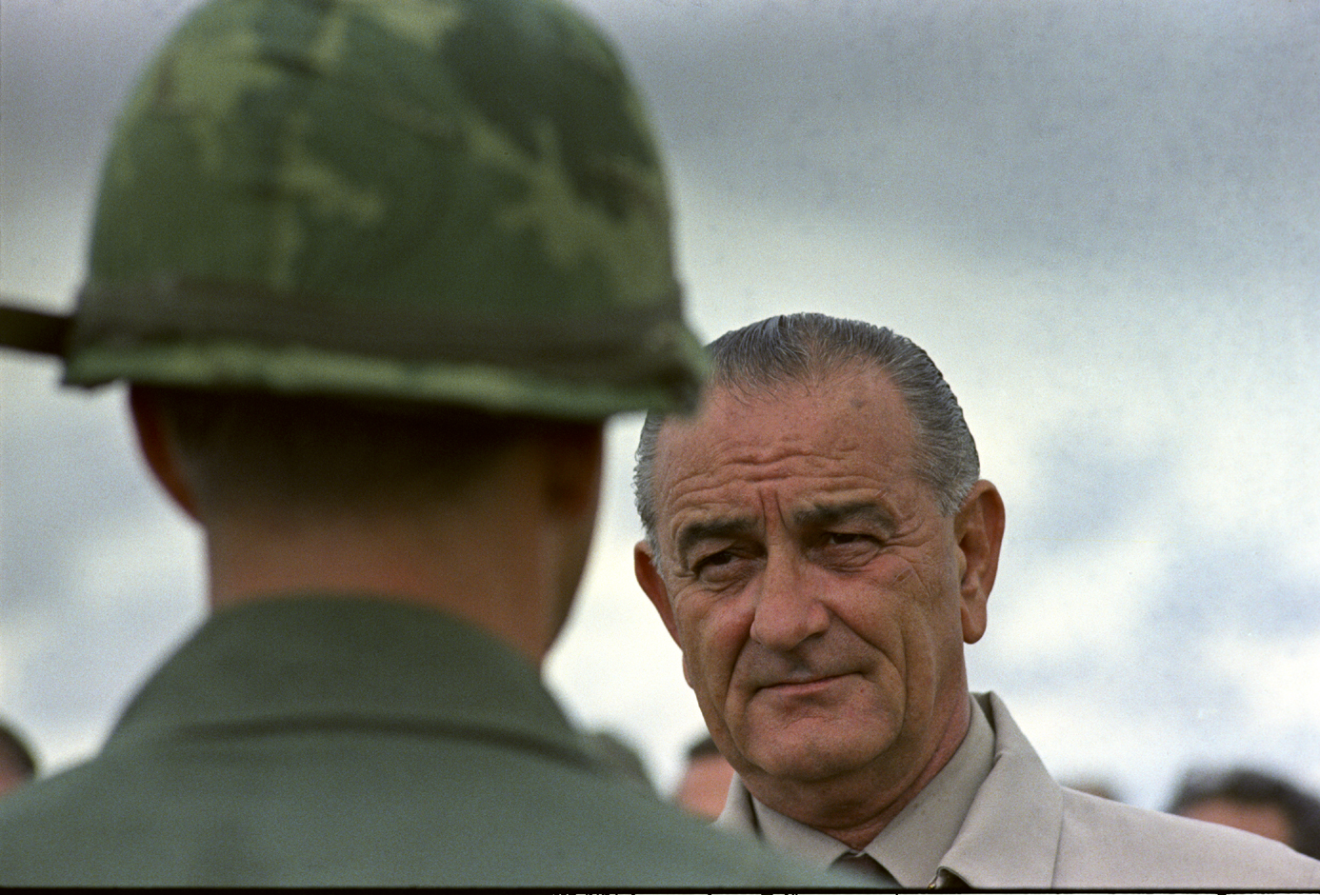
President Lyndon B Johnson

Slide 2
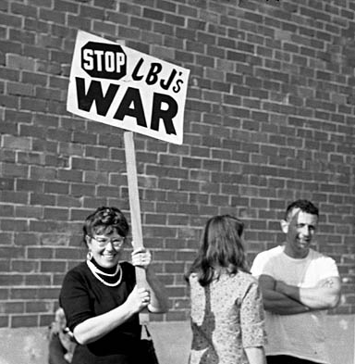
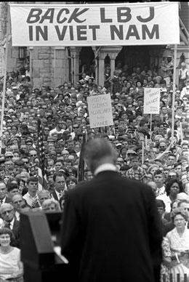

Slide 3
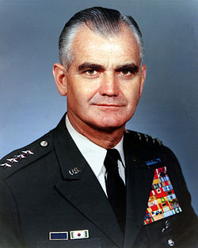
US General William Westmoreland

Slide 4
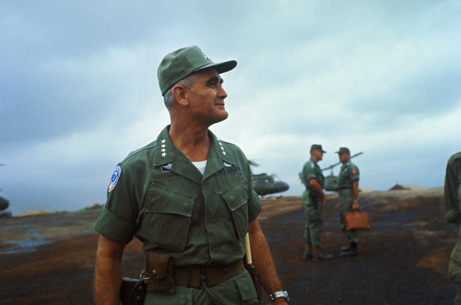

Slide 5
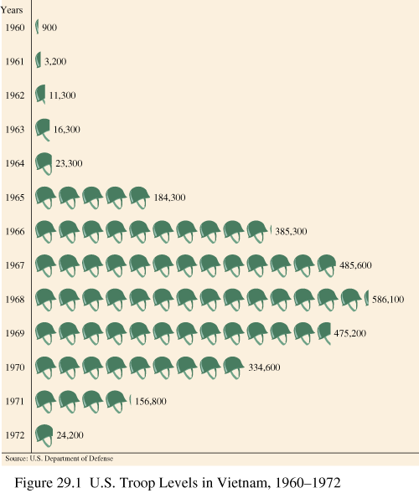
US Troop Levels in Vietnam 1960-1972

Slide 6
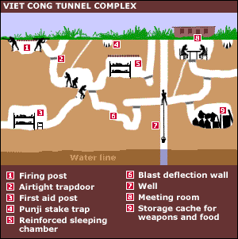

Slide 7
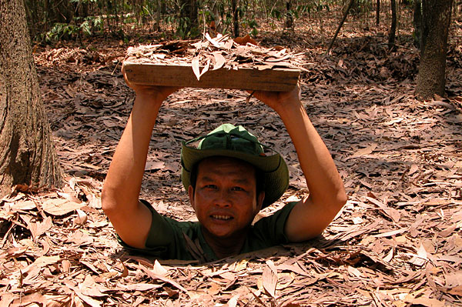

Slide 9
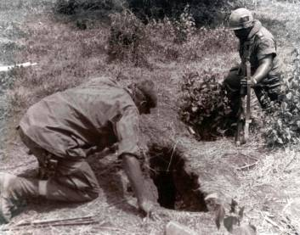
“The more the Americans tried to drive us away
from our land, the more we burrowed into it.”
Major Nguyen Quot

Slide 10
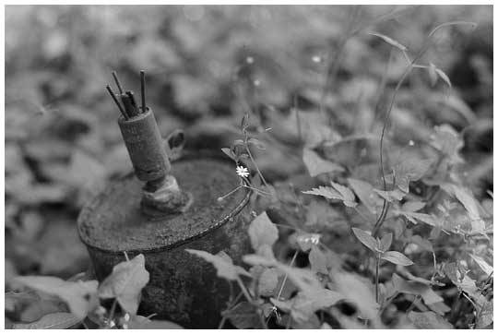
Around 3.5 million armed mines remain in Vietnam,
causing 160 civilian casualties each month.

Slide 11
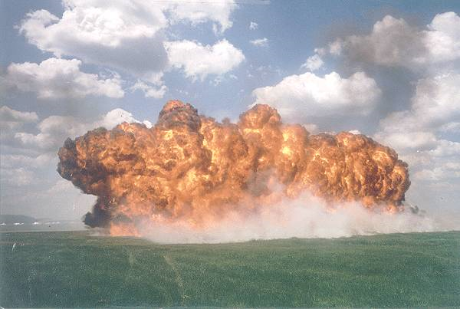

Slide 12
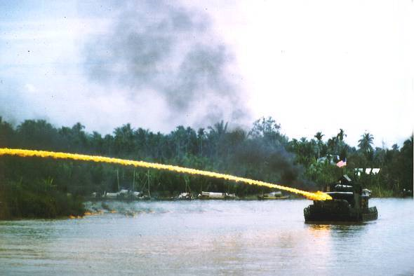
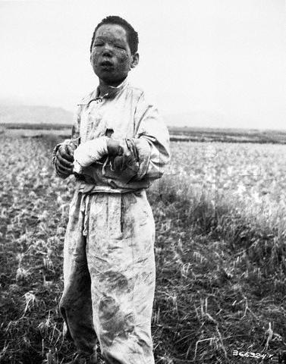

Slide 13
“We are taking young black men who had been crippled by our society and sending them eight thousand miles away to guarantee liberties in Southeast Asia which they had not found in Southwest Georgia and East Harlem…We have been repeatedly faced with the cruel irony of watching Negro and white boys on TV screens as the kill and die together for a nation that has been unable to seat them together in the same schools.”
MLK

Slide 14
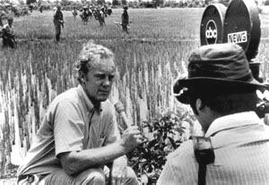

Slide 15
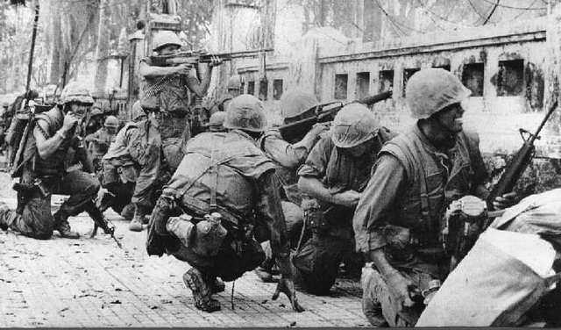
The Tet Offensive

Slide 16
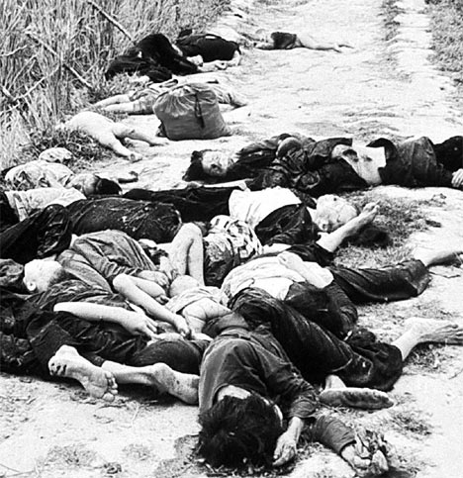
My Lai Massacre

Slide 17
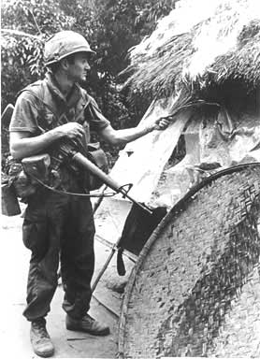

Slide 18
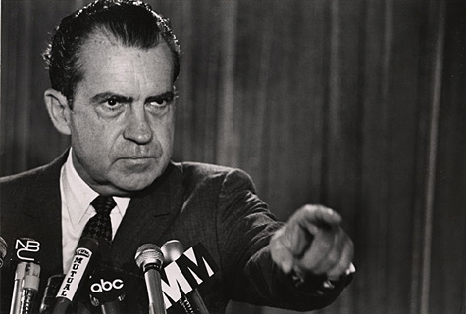
Richard Nixon

Slide 19
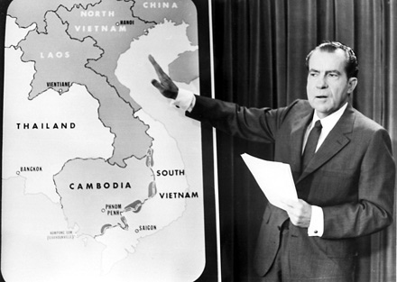
Vietnamization

