Slide 1
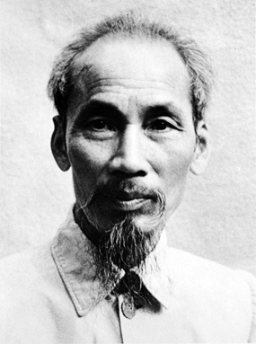
Ho Chi Minh

Slide 2
“Finally, you have broader considerations that might follow what you would call the "falling domino" principle. You have a row of dominoes set up, you knock over the first one, and what will happen to the last one is the certainty that it will go over very quickly. So you could have a beginning of a disintegration that would have the most profound influences.”

Slide 3
“If the Tiger (the Vietminh) pauses, the Elephant (the French) will impale him on his mighty tusks. But the Tiger will not pause, and the elephant with die of exhaustion and loss of blood.”
Ho Chi Minh
http://www.youtube.com/watch?v=8YSsetJU-tU

Slide 4
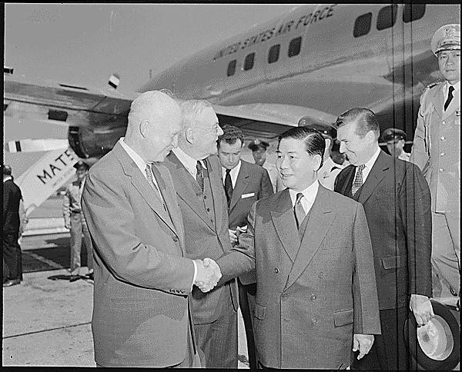

Slide 5
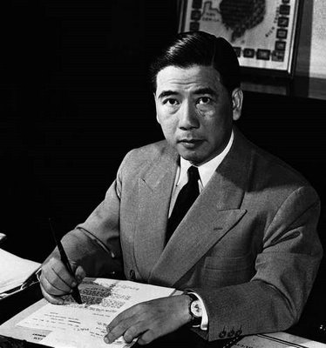
Ngo Dinh Diem

Slide 6
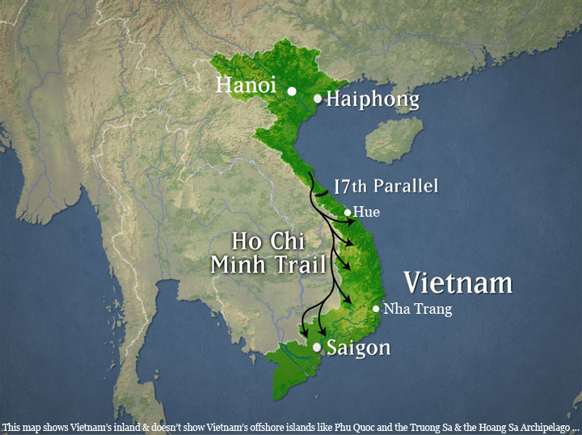

Slide 7
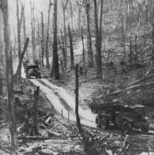
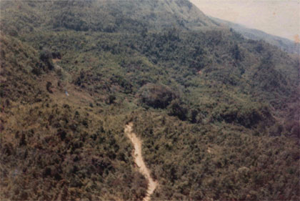
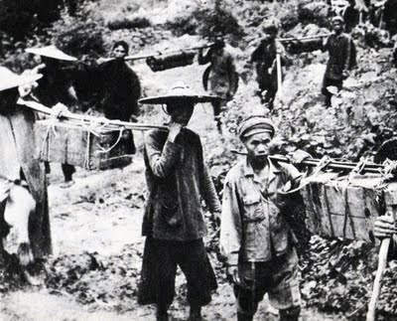
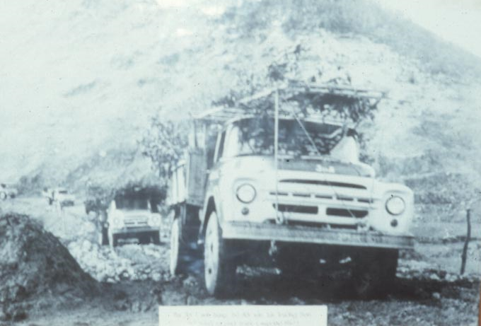

Slide 8
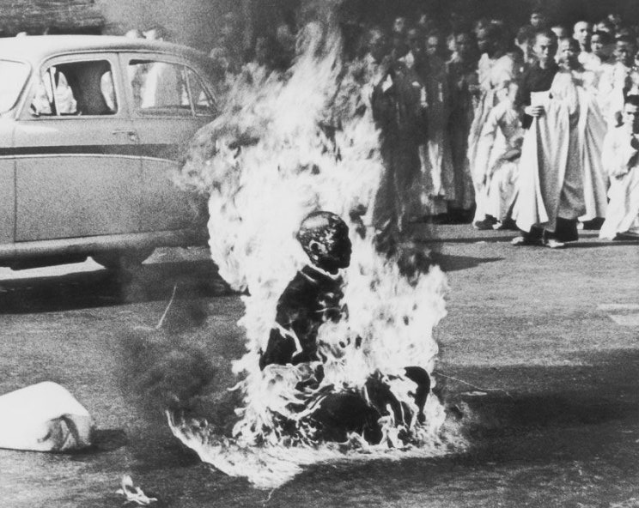

Slide 9
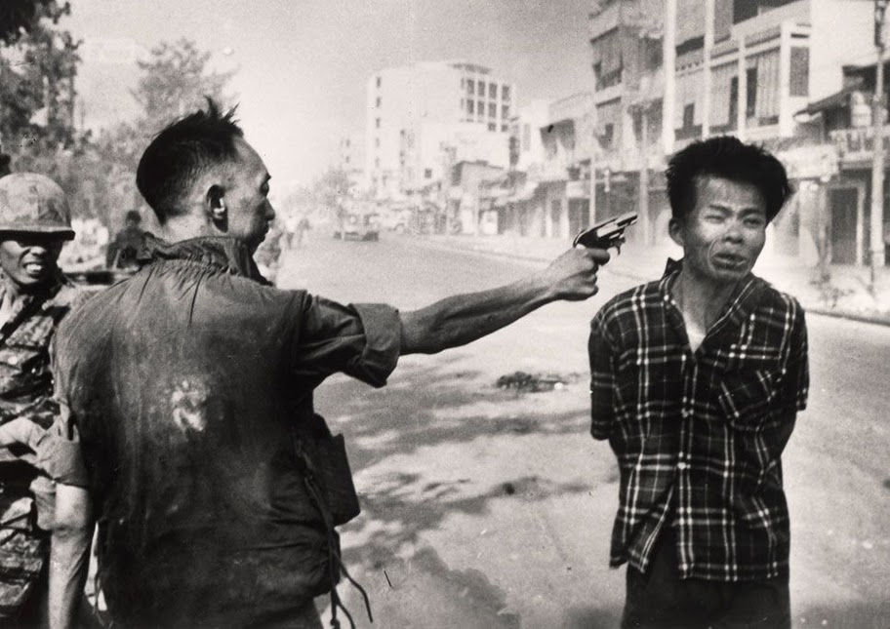

Slide 10
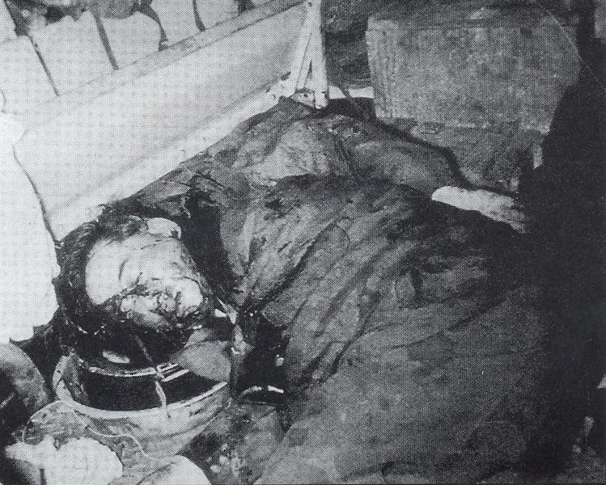

Slide 11
