Slide 1
U.S. Entry into WW I

Slide 2
TIMELINE
1900 – 1914: Beginning of World War I in Europe (events leading up to)
1914 – 1917: Europe was in World War I (US not involved)
1917 – 1918: US declares War (we get involved)
1918 – The War Ends
NAMES:
The Great War

Slide 3
3 SPARKS THAT FUELED THE FIRE
1. Nationalism
Fight for freedom and self-government
2. Imperialism
One country wants to control politics and economies of another
Tensions In Europe
3. Militarism
Building up strong armed forces preparing for war

Slide 4
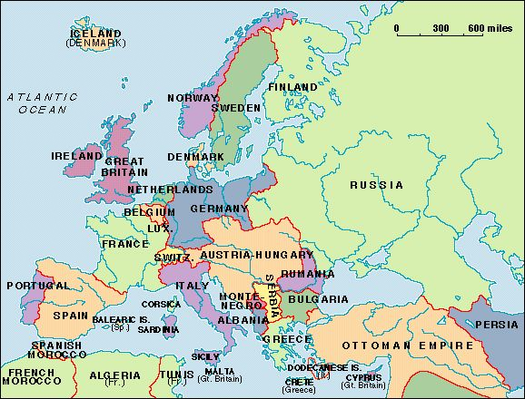

Slide 5
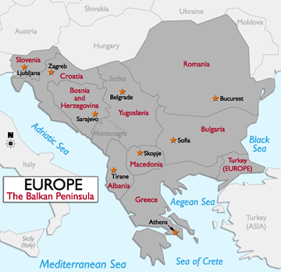
The Balkans In Crisis
For years, Nationalism had caused turmoil in the Balkan Peninsula. Various Nationalist groups also sought freedom from Austria-Hungary.
On June 28th, 1914, Archduke Franz Ferdinand, heir to the Austrian throne, visited Sarajevo.
Sarajevo was the capital of Bosnia, which was a part of Austria-Hungary.
As the Archduke rode through the city in an open car, a Serbian nationalist through a bomb into the car. The Archduke quickly threw it out before it exploded only to be fatally shot by Gavrilo Princip.

Slide 6
Alliances Lead To War
Triple Alliance a.k.a Central Powers
Germany, Austria-Hungary, Italy, Bulgaria, Turkey
Triple Entente a.k.a. Allied Powers
France, Russia, Britain, Serbia, Belgium (by the end of the war 21 nations would join the Allied Powers, including Italy)
European Declaration of War
July 28th, 1914 – Austria Hungary declared war on Serbia
August 1st, 1914 – Germany declared war on Russia
August 3rd, 1914 – Germany declared war on France
Last but not least…Britain declared war on Germany on August 4th

Slide 7
AMERICAN NEUTRALITY
Public Opinion was Divided -
The US had longstanding ties with Britain due to the fact that we shared the same language, culture, and traditions.
Trade increased more with the Allied Powers than it did with the Central Powers.
On the other hand, 8 million Americans were of German or Austrian decent. The Irish favored the Central Powers as well.

Slide 8
Submarine Warfare/ The Lusitania
Submarines were known as U-Boats during this time.
U-Boats moved slowly, and were made out of a thin metal that could be destroyed easily. For this reason they torpedoed any ship in sight.
One of the ships they torpedoed was a British passenger ship called the Lusitania.
1,200 people died from this explosion, and 128 of them were Americans.

Slide 9
Allied Ships Sunk by U-Boats

Slide 10
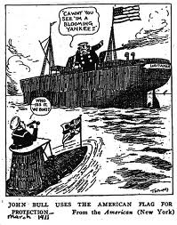
Lusitania

Slide 11
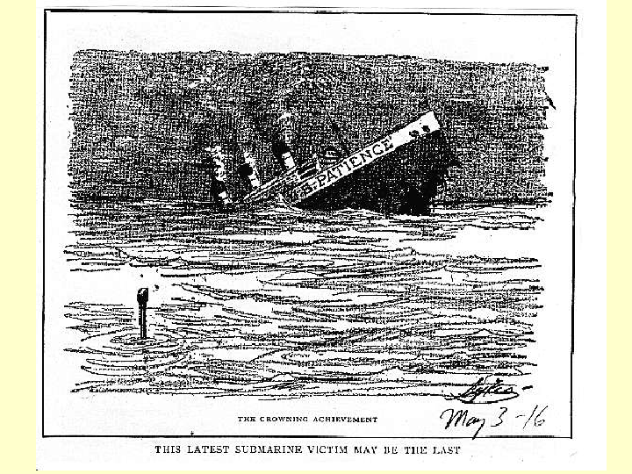

Slide 12
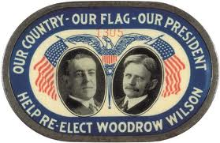
He kept us out of the war….Election of 1916

Slide 13
The Zimmerman Telegram
A secret note from the German foreign secretary, Arthur Zimmerman, to the German minister in Mexico.
The telegram instructed the German minister to urge
the Mexican Government to attack the United States if the
United States declared war on Germany. If they would do
this then Germany would help Mexico regain territory they
lost to America after the Mexican War.
Anti-German feelings soared in the United States when news of this telegram was revealed.

Slide 14
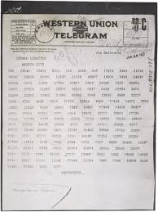
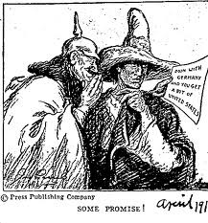

Slide 15
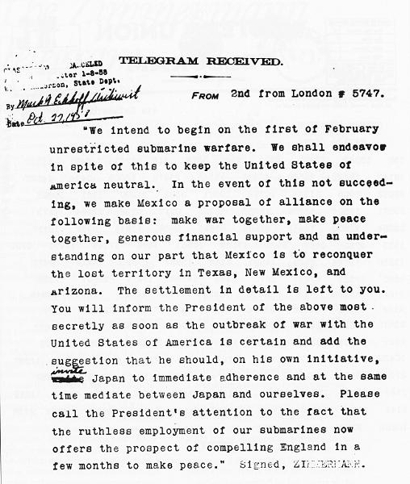

Slide 16
The Yanks Are Coming!

Slide 17
American Entrance
3 Main Reasons For American Entrance Into World War I:
1. Sinking of the Lusitania and other merchant ships
2. The Zimmerman Telegram
3. The Revolution in Russia
On April 6th, 1917, President Woodrow Wilson signed a Declaration of War, and the United States entered World War I.

