Slide 1
The West after Civil War

Slide 2
Homestead Act
http://www.archives.gov/education/lessons/homestead-act/

Slide 3
Buffalo Hunters

Slide 5
A single hunter could kill 250 buffalo a day
Tanneries paid $3.00 per hide and the tongues brought .25 each.
By 1800 5,000 buffalo hunter were busy supplying buffalo robes and tongues for market.
Teddy Roosevelt went on one of the last buffalo hunts in 1883.

Slide 6
Railroad Map
http://www.cprr.org/Museum/Maps/

Slide 7
Ft. Laramie Treaties
1851…The pioneers can move freely on the Oregon trail. The military can build forts to protect them.
The Indians get $50,000 a year for 50 years as a trespass payment.
1868…Guaranteed the rights to the Black Hills and hunting lands in Wyoming, Montana, Dakotas…

Slide 8
Sandcreek Massacre 1864
Took place during Pikes Peak gold rush.
Treaties were being broken when miners flooded out of the mountains onto the plains and the Native hunting grounds.
Colonel Chivington put together a volunteer regiment of people he could find around Denver. Most soldiers were fighting in Civil War. The volunteers signed on for 100 days.
Nearing the end of their 100 day enlistment the men were anxious to fight Indians.
They ended up finding the Arapaho and Northern Cheyenne at Fort Lyon in Eastern Colorado.
Chivington’s men shot down and scalped the men, women, and children even though they were under a white flag.
When asked why he did what he did Chivington responded, “Nits make Lice.”
The Sandcreek massacre lead to future animosity between the whites and plains tribes.

Slide 9
Nezperce Retreat
1876
Idaho gold rush caused contention and shrunk the size of the reservation.
Young warriors attacked the white settlements.
What choices did the Nez Pierce have?
Why is “Chief Joseph” famous?

Slide 11
Chief Joseph’s Speech
I am tired of fighting. Our chiefs are killed. Looking Glass is dead. Toohulhulsote is dead. The old men are all dead. It is the young men who say yes or no. He who led the young men is dead.
It is cold and we have no blankets. The little children are freezing to death. My people, some of them, have run away to the hills and have no blankets, no food. No one knows where they are--perhaps freezing to death. I want to have time to look for my children and see how many I can find. Maybe I shall find them among the dead.
Hear me, my chiefs. I am tired. My heart is sick and sad. From where the sun now stands, I will fight no more forever.

Slide 12
Battle of Little Bighorn
Gold Rush in the Blackhills causes the Indians to unite in opposition to the white intrusion.
The Lakota and Cheyenne left the reservation and attacked white settlements. Their justification was that the Fort Laramie Treaty of 1868 had been broken.
260 soldiers lead by George Armstrong Custer went to push back the Indians despite the warnings that they should wait for reinforcements.
Custer split his forces and was surrounded by the Indians. He ordered his men to shoot the horses to make a wall to hide behind. Despite his efforts he was killed along with 210 of his men.
While this battle is often called “Custer’s” last stand, it was also the Indians last stand.

Slide 13
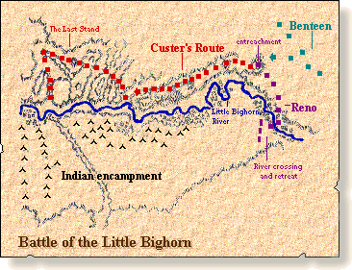
Battle of Little Bighorn Map

Slide 14
Wounded Knee South Dakota
The Paiute Prophet Wavoka had a vision. If the Indians would perform the Ghost Dance their traditions, culture, and the buffalo would come back. He also said that the earth would swallow the white man.
This was a very inviting idea to Indians who remembered their life prior to white settlement.
Indians all over the Plains started to perform the Ghost Dance.
The U.S. Gov. made it illegal to perform the Ghost Dance.

Slide 15
Wounded Knee Movie
http://www.youtube.com/watch?v=dc7fZonjD1M

Slide 16
General Miles sent this telegram from Rapid City to General John Schofield in Washington, D.C. on December 19, 1890:
"The difficult Indian problem cannot be solved permanently at this end of the line. It requires the fulfillment of Congress of the treaty obligations that the Indians were entreated and coerced into signing. They signed away a valuable portion of their reservation, and it is now occupied by white people, for which they have received nothing.
They understood that ample provision would be made for their support; instead, their supplies have been reduced, and much of the time they have been living on half and two-thirds rations. Their crops, as well as the crops of the white people, for two years have been almost total failures.
The dissatisfaction is wide spread, especially among the Sioux, while the Cheyenne's have been on the verge of starvation, and were forced to commit depredations to sustain life. These facts are beyond question, and the evidence is positive and sustained by thousands of witnesses."

Slide 17
Dawes Act 1887
The Dawes Act gave the Indians individual ownership of their land on the reservations.
It was similar to the Homestead Act in the sense that the land was divided then the Indians could choose which piece of land they wanted. If they didn’t choose one the Department of Interior chose for them.
The Act had the intention of assimilating Indians into white society by teaching them about land ownership.
If you own the land you can sell it. Many Indians did because they didn’t know what else to do.
Today the reservations look like “Swiss-cheese” because whites bought the best pieces of land available.

Slide 18
Oklahoma Land Rush 1889
The last Homestead Act in the lower 48 states.
Indian Territory was shrunk down and Oklahoma was opened for white settlement.
There were so many people hungry for land that they literally raced for it.
http://www.youtube.com/watch?v=yxaJY8UZxn4

Slide 19
Frederick Jackson Turner: Frontier Thesis 1890
Turner argued that the American character was formed by moving west.
The west was an escape valve for the American people to throw off European customs, start a new life during economic problems, shed a criminal past etc…
The ruggedness of the west formed a rugged American people who could adapt to their environment and come up with new solutions for their problems.
Turners “Frontier Thesis” was given at the Chicago Worlds Fair in 1893. He claimed that the frontier had ended when the census of 1890 showed too many people per square mile to be considered frontier any more.

Slide 20
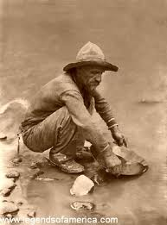
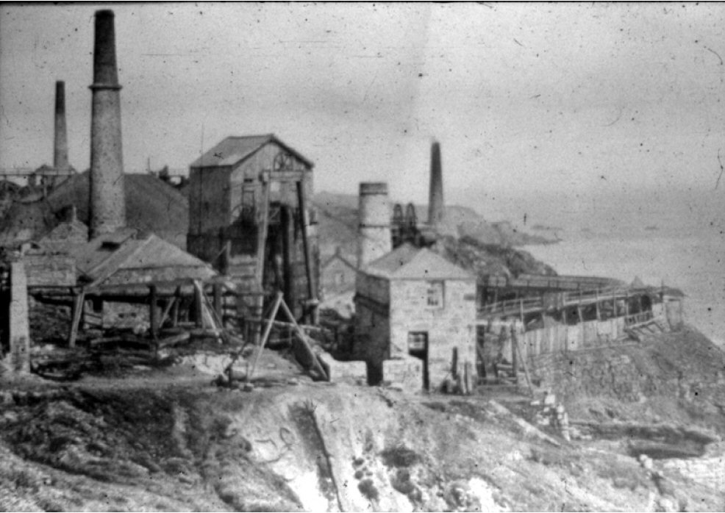
Mining and Farming: Was rugged individualism successful?

Slide 21
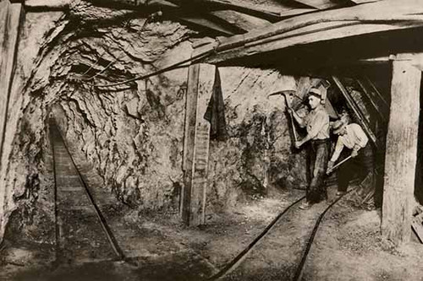

Slide 22
