Slide 1
The 1st Red Scare

Slide 2
Government Excess & Threats to the Civil Liberties of Americans
5. Post-war labor unrest:
  Coal Miners Strike of 1919.
  Steel Strike of 1919.
  Boston Police Strike of 1919.

Slide 3
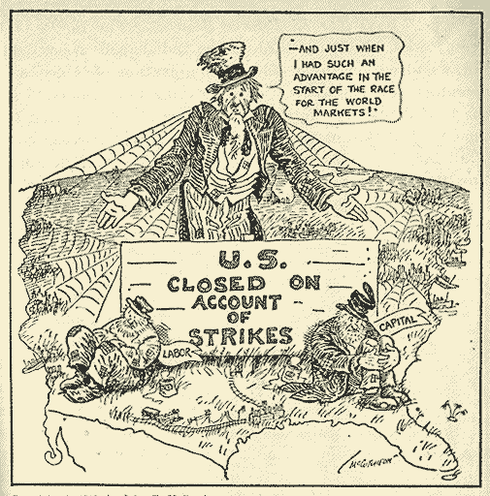
Anti-Labor
“If Capital & Labor Don’t Pull Together” – Chicago Tribune

Slide 4
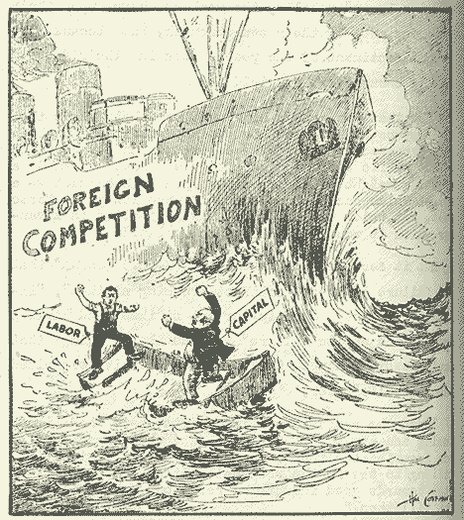
Consequences of Labor Unrest
“While We Rock the Boat” – Washington Times

Slide 5
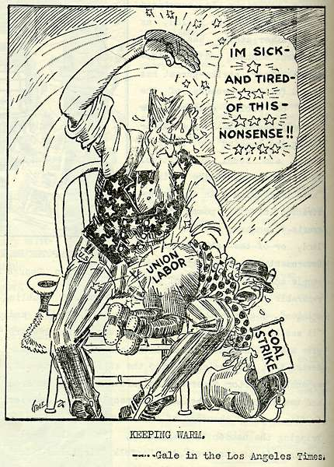
Coal Miners’ Strike - 1919
“Keeping Warm” – Los Angeles Times

Slide 6
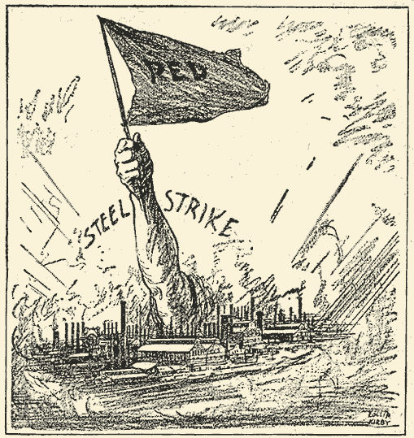
Steel Strike - 1919
“Coming Out of the Smoke” – New York World

Slide 7
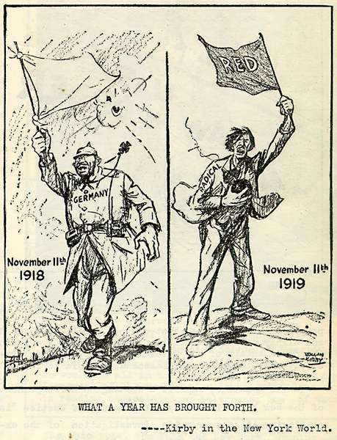
The “Red Scare”
“What a Year Has Brought Forth” – NY World

Slide 8
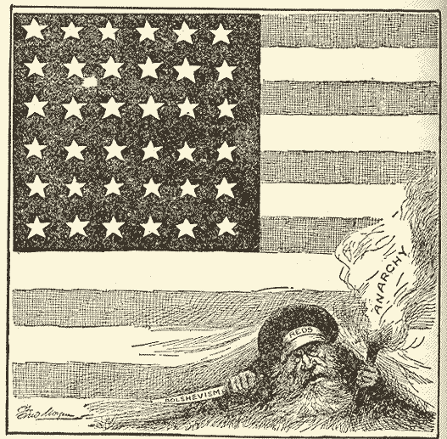
“Red Scare” -- Anti-Bolshevism
“Put Them Out & Keep Them Out” – Philadelphia Inquirer

Slide 9
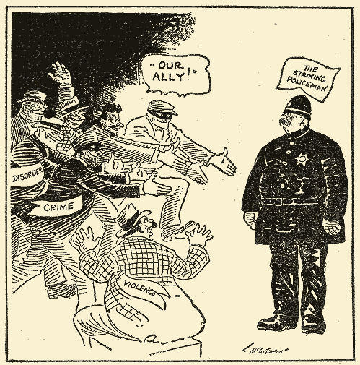
Boston Police Strike - 1919
“He gives aid & comfort to the enemies of society” – Chicago Tribune

Slide 10
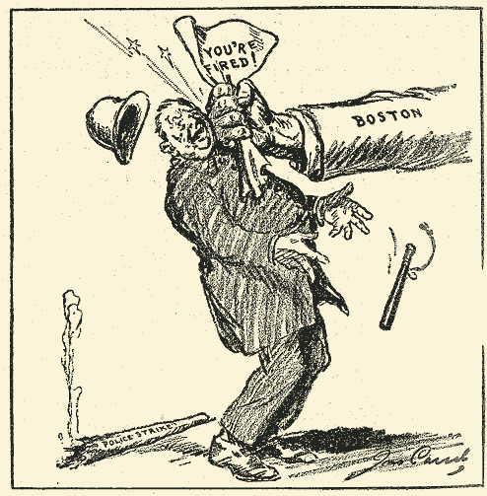
Boston Police Strike - 1919
“Striking Back” – New York Evening World

Slide 11
Government Excess & Threats to the Civil Liberties of Americans
6. “The Red Scare”:
1919 - 3rd. International
goal --> promote worldwide
communism.
Attorney General, A. Mitchell Palmer (The Case Against the Reds)
Palmer Raids - 1920

Slide 12
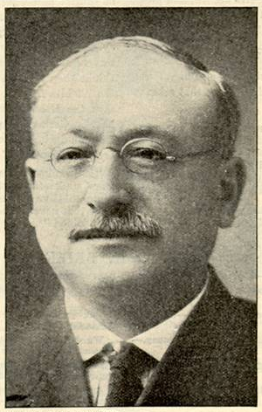
Congressman Victor Berger (WI)
You got nothing out of the war except the flu and Prohibition.

Slide 13
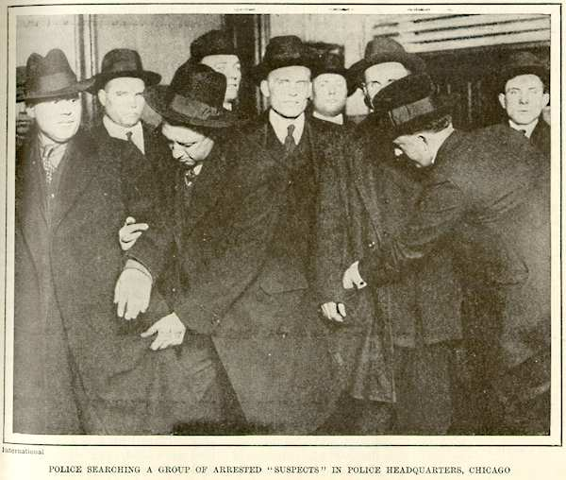
“Red Scare” – Palmer Raids
Police Arrest “Suspected Reds’ in Chicago, 1920

Slide 14
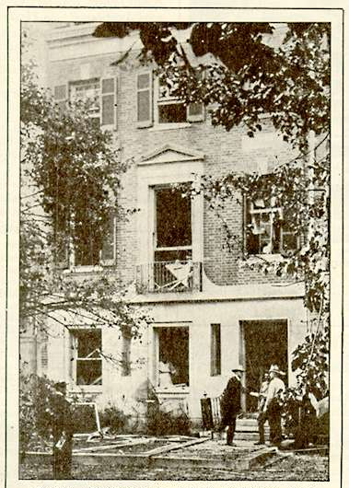
“Red Scare” – Palmer Raids
A. Mitchell Palmer’s Home Bombed, 1920

Slide 15
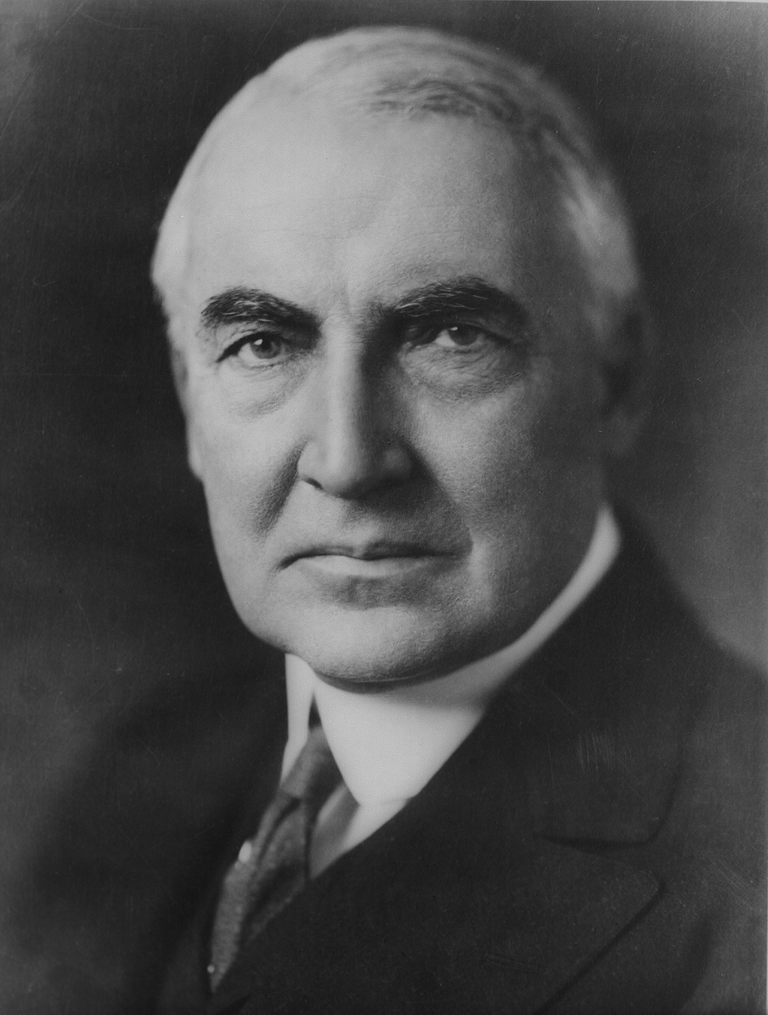
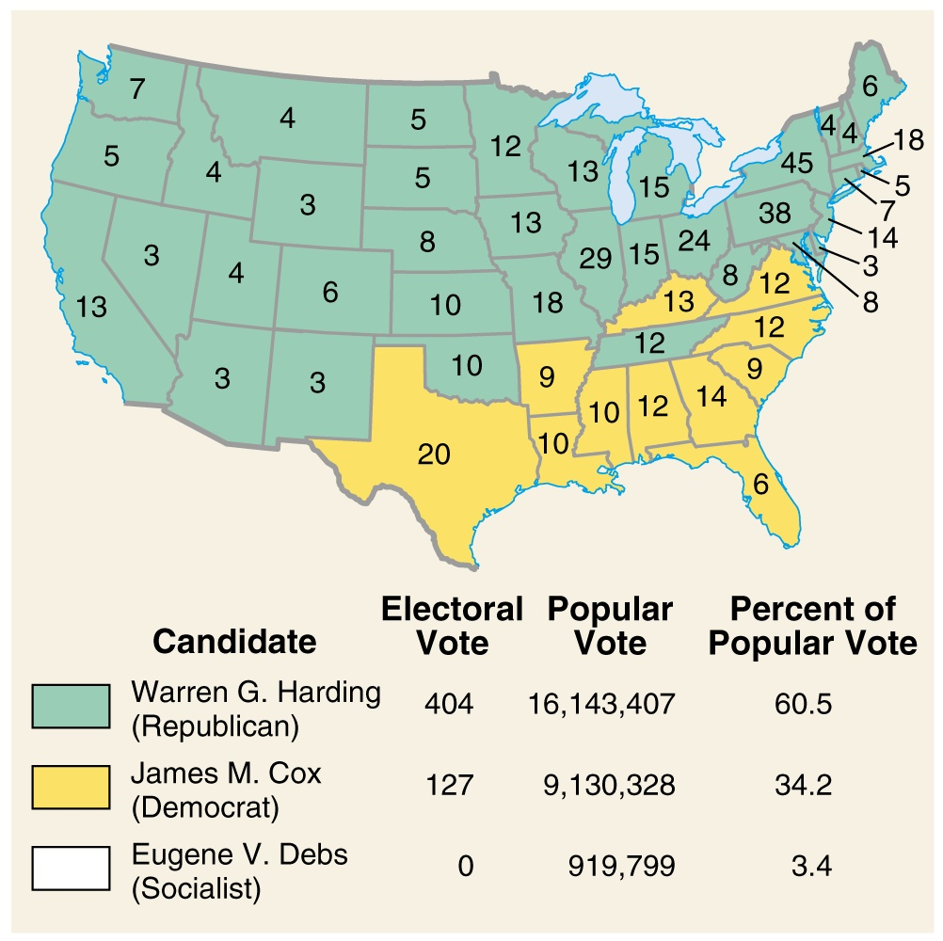
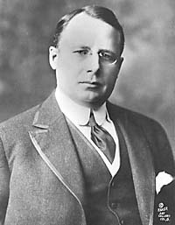
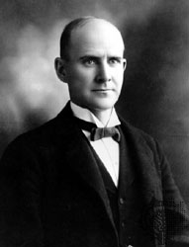
The 1920 Election

