Slide 1
SOCIAL JUSTICE
John Spargo
The Bitter Cry of the Children
Jacob Riis
How the Other Half Lives

Slide 4
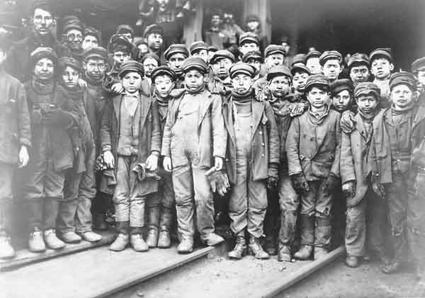

Slide 6
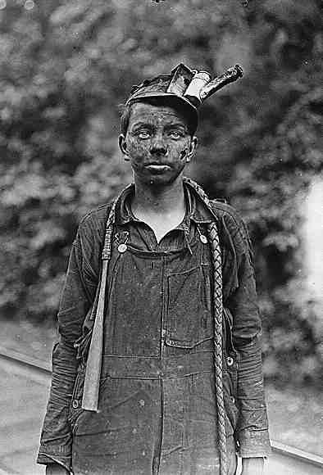
SOCIAL JUSTICE
John Spargo: The Bitter Cry of the Children

Slide 8
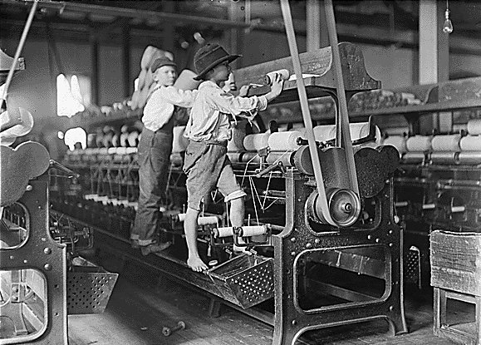

Slide 9
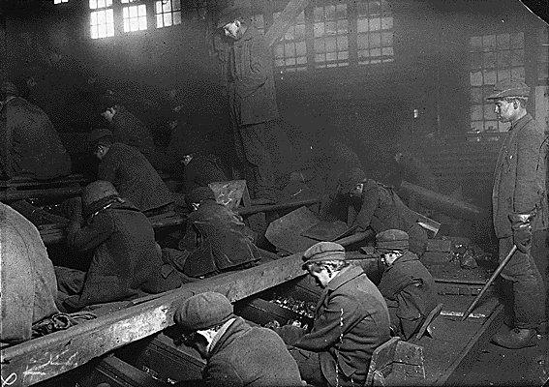

Slide 10
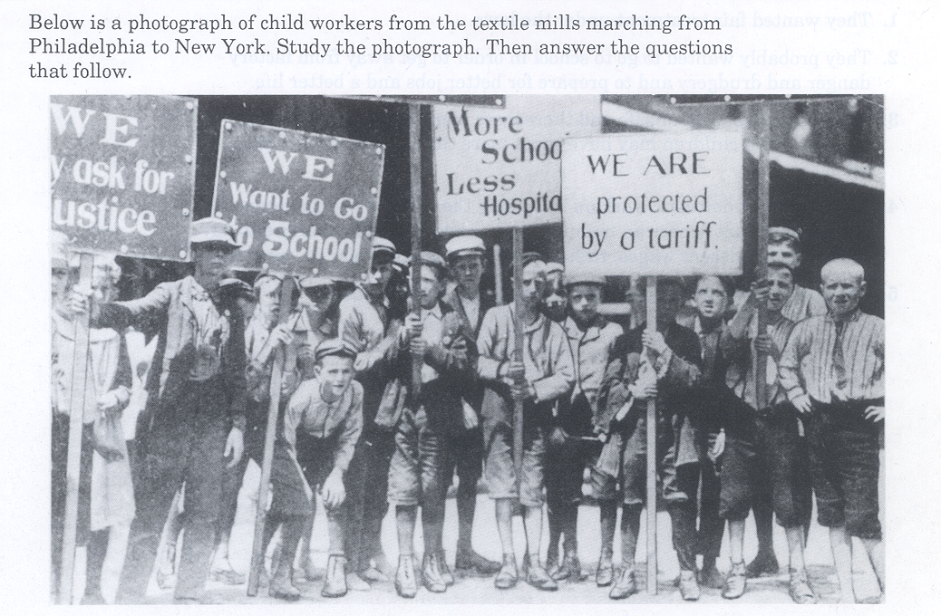

Slide 11
Social Reformers
Jane Addams
SOCIAL GOSPEL
Pioneer in the field of social work who founded the settlement house movement through the establishment of Hull House in Chicago, Illinois.
Margaret Sanger
Educated urban poor about the benefits of family planning through birth control. She founded the organization that became Planned Parenthood.

