Slide 1
PROGRESSIVES
1890 to 1917
“Progressives were reformers who attempted to solve problems caused by industry, growth of cities and laissez faire.”

Slide 2
Progressives were
White Protestants
Middle class and native born.
College Educated Professionals
Social workers
Scholars
Politicians
Preachers
Teachers
Writers

Slide 3
PROGRESSIVES
Reform = Progress
Always possible and good
Progress not inevitable but blocked by ignorance and corruption
Everyone / everything can be improved
Traditions = automatically suspect
Experts can ALWAYS find one best way
Education & Purity always = progress.
Mission = Progress for world

Slide 4
PROGRESSIVES
When did the movement begin?
Farmers organize during the 1870’s
The Grange—1867---local level
Farmer’s Alliance---state level
Populist Party--national level People’s Party

Slide 5
PROGRESSIVES
Adopt Populist Ideas
Move away from laissez faire with government regulating industry
Make US government responsive to the people (voting)
Limit power of the political bosses.
Improve worker’s rights, conditions for poor and immigrants
Clean up the cities
End segregation and Jim Crow

Slide 6
PROGRESSIVES
Populists vs Progressives
Populists---rural
Progressives---cities
Populists were poor and uneducated
Progressives were middle-class and educated.
Populists were too radical
Progressives stayed political mainstream.
Populists failed
Progressives succeeded

Slide 7
PROGRESSIVES
Areas to Reform
Social Justice
Political Democracy
Economic Equality
Conservation

Slide 8
PROGRESSIVES
Social Justice Improve working conditions in industry, regulate unfair business practices, eliminate child labor, help immigrants and the poor

Slide 9
PROGRESSIVES
Political Democracy Give the government back to the people, get more people voting and end corruption with political machines.

Slide 10
PROGRESSIVES
Economic Justice
Fairness and opportunity in the work world, regulate unfair trusts and bring about changes in labor.
Demonstrate to the common people that U.S. Government is in charge and not the industrialists.

Slide 11
PROGRESSIVES
CONSERVATION
Preserve natural resources and the environment

Slide 12
SOCIAL JUSTICE
MUCKRAKERS
Muckrakers were journalists and photographers who exposed the abuses of wealth and power.
They felt it was their job to write and expose corruption in industry, cities and government.
Progressives exposed corruption but offered no solutions.

Slide 13
SOCIAL JUSTICE
They believed that if the public could only see or read for itself…..
There would be an outcry and people would want to help make conditions better…..
Or demand the government to make reforms.
“Digging up the dirt” = Investigative Journalism

Slide 14
Progressive Presidents
Theodore Roosevelt 1901 to 1909
William Howard Taft 1909 to 1913
Woodrow Wilson 1913 to 1921

Slide 15
Muck
raker
Muck
raker
Work
Work
Subject
Subject
Results
Results
Thomas Nast
Political Cartoons
Political corruption by NYC's political machine, Tammany Hall, led by Boss Tweed.
Tweed was convicted of embezzlement and died in prison.
Jacob Riis
John Spargo
Living conditions of the urban poor; focused on tenements.
Child labor in the factories and education for children.
NYC passed building codes to promote safety and health.
Ending child labor and increased enrollment in schooling.
How the Other Half Lives (1890)
The Bitter Cry of the Children
Investigated dangerous working conditions and unsanitary procedures in the meat-packing industry.
In 1906 the Meat Inspection Act and Pure Food and Drug Act were passed
Upton Sinclair
The Jungle (1906)

Slide 16
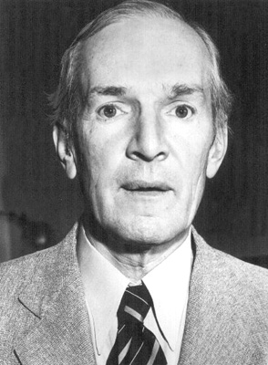
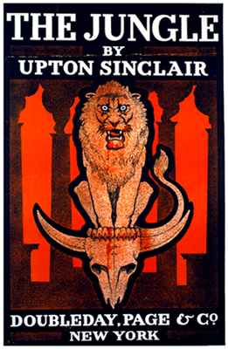
SOCIAL JUSTICE
Upton Sinclairs, The Jungle, exposed the filthy, unsanitary working conditions and corruption in a meatpacking company in Chicago

Slide 17
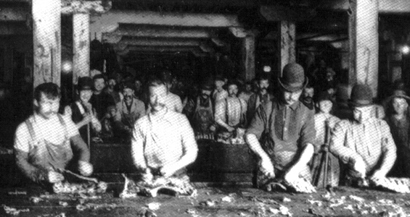
SOCIAL JUSTICE

Slide 18
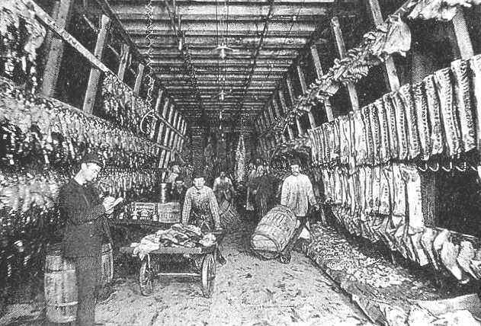
SOCIAL JUSTICE

Slide 19
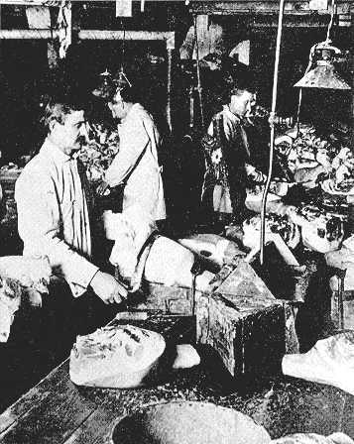
SOCIAL JUSTICE
President Roosevelt proposed legislation to clean up the meatpacking industry after reading The Jungle.
Food and Drug Act
Meat Inspection Act

Slide 20
SOCIAL JUSTICE
Reading The Jungle, TR brought about reform in proposing and signing into law the Meat Inspection Act, 1906
All meat sold must inspected
Must be marked by Federal inspectors and graded.
Meat industry cleaned up.
Fish is regulated.

Slide 21
SOCIAL JUSTICE
Pure Food and Drug Act, 1906
Federal inspection to all packaged foods and drugs.
Labels with medicine as well as food.
Contents of food and drug packages must be listed
All additives/chemicals must be listed on labels.
FDA today or Food and Drug Administration

