Slide 1
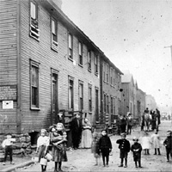
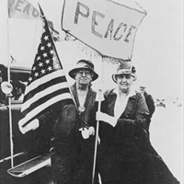
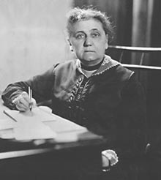
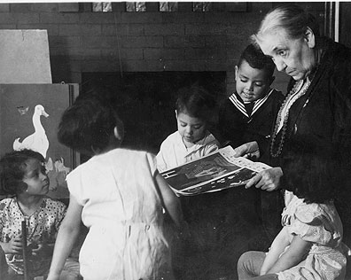
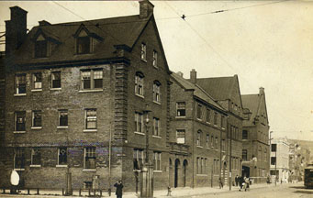
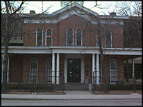
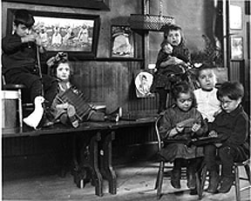
JANE ADAMMS
SETTLEMENT HOUSE
JANE ADAMMS
SETTLEMENT HOUSE
To provide a center for higher civic and social life; to institute and maintain educational and philanthropic enterprises.
To investigate and improve the conditions in the industrial districts of Chicago.
To help assimilate the immigrant population
To provide a center for higher civic and social life; to institute and maintain educational and philanthropic enterprises.
To investigate and improve the conditions in the industrial districts of Chicago.
To help assimilate the immigrant population
RUN BY COLLEGE EDUCATED WOMEN
provide educational, cultural, social services
send visiting nurses to the sick
help with personal, job, financial problems

Slide 2
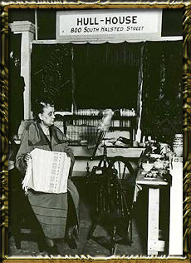
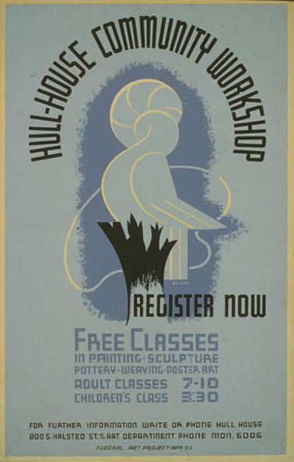
JANE ADAMMS
SETTLEMENT HOUSE
In 1889, the settlement house movement spread rapidly.
By 1900 more than 400 houses had been established in major cities across the country.

Slide 3
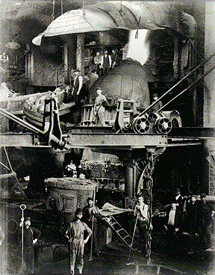
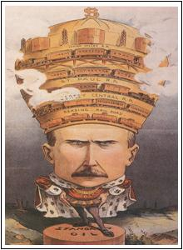
SOCIAL JUSTICE
Hiram Johnson---Governor of Calif.
Worker’s compensation
State insurance supported workers injured on the job.
Robert La Follette---Gov. of Wisconsin
Wisconsin Idea = La Follette Plan
Taxes on incomes and corporations

Slide 4
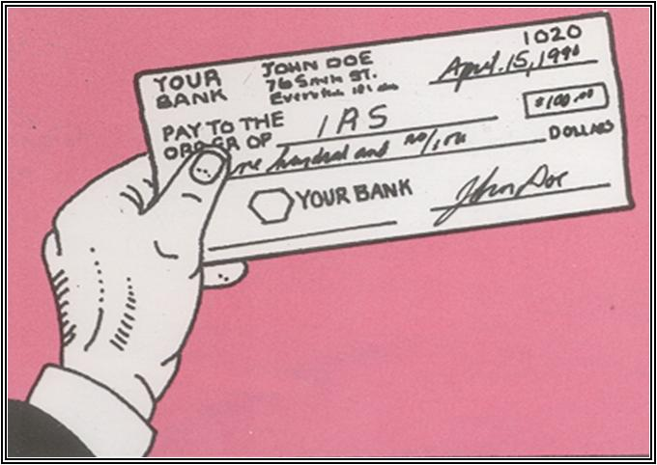
SOCIAL JUSTICE
16th Amendment: Income Tax (1913) Progressive income tax assigned higher tax rates to people with higher incomes.

Slide 5
SOCIAL JUSTICE
18th Amendment: Prohibition (1919) Banned manufacture and sale of alcoholic beverages
Movement begins at the local, state levels and eventually effects the national level…..
WCTU or Women’s Christian Temperance Union founded in 1874 in Cleveland, Ohio
Frances Willard
Carrie Nation
Anna Howard Shaw
Anti-Saloon League

Slide 6
Muck
raker
Work
Subject
Results
Frank Norris
The Octopus (1901)
This fictional book exposed monopolistic railroad practices in California.
In Northern Securities v. U.S. (1904), the holding company controlling railroads in the Northwest was broken up.
Ida Tarbell
"History of Standard Oil Company" in McClure's Magazine (1904)
Exposed the ruthless tactics of the Standard Oil Company through a series of articles published in McClure's Magazine.
In Standard Oil v. U.S. (1911), the company was declared a monopoly and broken up.

Slide 7
Muck
raker
Work
Subject
Results
Social Reformers
Booker T. Washington
Former slave who founded the Tuskegee Institute that focused on teaching African-Americans trade skills to earn a living and gain the trust of white society.
Provided statistics on the lynching of African-Americans.
NAACP joined the fight for Federal anti-lynching legislation.

Slide 8
City Reforms
City Commissioner Plan
Cities hired experts in different fields to run a single aspect of city government. For example, the sanitation commissioner would be in charge of garbage and sewage removal.
City Manager Plan
A professional city manager is hired to run each department of the city and report directly to the city council.

Slide 9
State Reforms
Recall
Allows voters to petition to have an elected representative removed from office.
Initiative
Allows voters to petition state legislatures in order to consider a bill desired by citizens.
Referendum
Allows voters to decide if a bill or proposed amendment should be passed.
Privacy at the ballot box ensures that citizens can cast votes without party bosses knowing how they voted.
Secret Ballot
Ensures that voters select candidates to run for office, rather than party bosses.
Direct Primary

Slide 10
AUSTRALIAN BALLOT
Given out only at the polls
Vote in secret
Printed at public expense
Lists names of all candidates and their parties

Slide 11
POLITICAL DEMOCRACY
1790 to 1828
Caucus---small group of individuals who would choose a candidate
1828 to 1900
Convention---members from the political parties nominate a candidate
Current System Used
Direct Primary---allow registered voters to participate in choosing a candidate

Slide 12
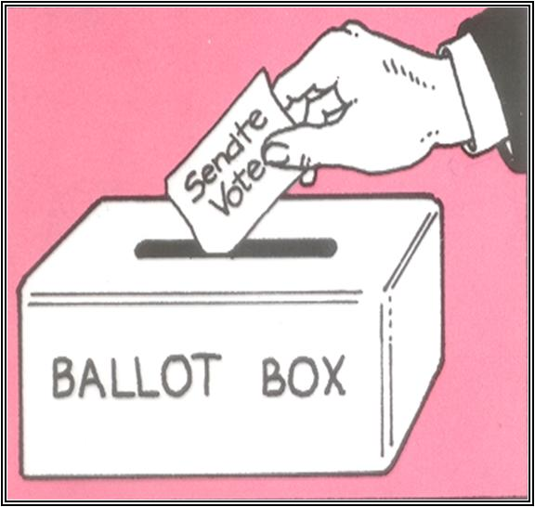
POLITICAL DEMOCRACY
NATIONAL LEVEL
17th Amendment: Direct Election of Senators (1913) Increased voters’ power and reduced corruption in Senate

Slide 13
POLITICAL DEMOCRACY
NATIONAL LEVEL
19th Amendment
Women’s Suffrage (1920)
Women won the right to vote

Slide 14
Preparing the Way for Suffrage
American women activists first demanded the right to vote in 1848 at the Seneca Falls Convention in New York.
The movement eventually split into two groups:
The National Woman Suffrage Association fought for a constitutional amendment for suffrage.
The American Woman Suffrage Association worked to win voting rights on the state level.
In 1890, Wyoming entered the union and became the first state to grant women the right to vote.
In 1872, in an act of civil disobedience, a suffrage leader, Susan B. Anthony, insisted on voting in Rochester, New York. She was arrested for this act.

Slide 15
Suffragist Strategies
NWSA
AWSA
Constitutional Amendment
Winning suffrage by a constitutional amendment
The first federal amendment was introduced in Congress in 1868 and stalled.
In 1878, suffragists introduced a new amendment.
Stalled again, the bill was not debated again until 1887. It was defeated by the Senate.
The bill was not debated again until 1913.
Individual State Suffrage
Winning suffrage state by state
State suffrage seemed more successful than a constitutional amendment.
Survival on the frontier required the combined efforts of men and women and encouraged a greater sense of equality.
Western states were more likely to allow women the right to vote.

Slide 16
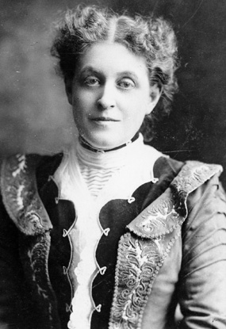
A New Generation Women’s Suffrage
Susan B. Anthony and Elizabeth Cady Stanton, leaders of the suffrage movement, died without seeing the victory of women’s suffrage.
At the turn of the century, Carrie Chapman Catt became the leader of the National American Woman Suffrage Association (NAWSA).
She led the movement from 1900 to 1904 and again after 1915.
In March 1913 Alice Paul and Lucy Burns organized a parade of 5,000 women in Washington, D.C.

Slide 17
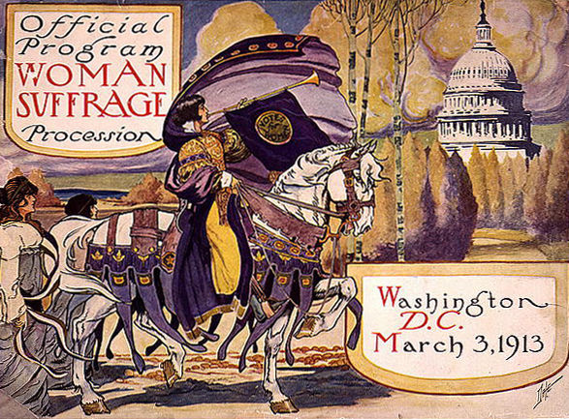
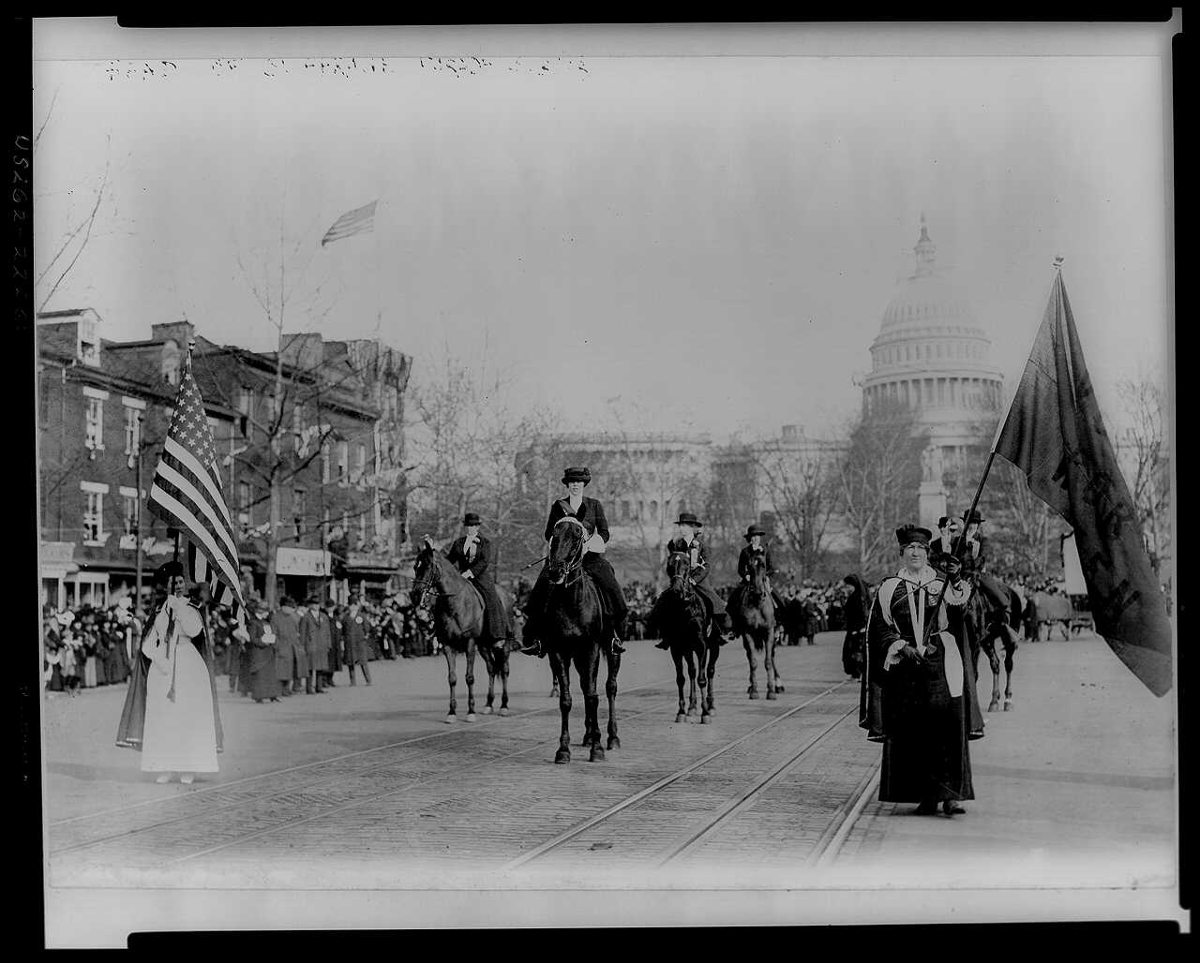
A New Generation Women’s Suffrage

Slide 18
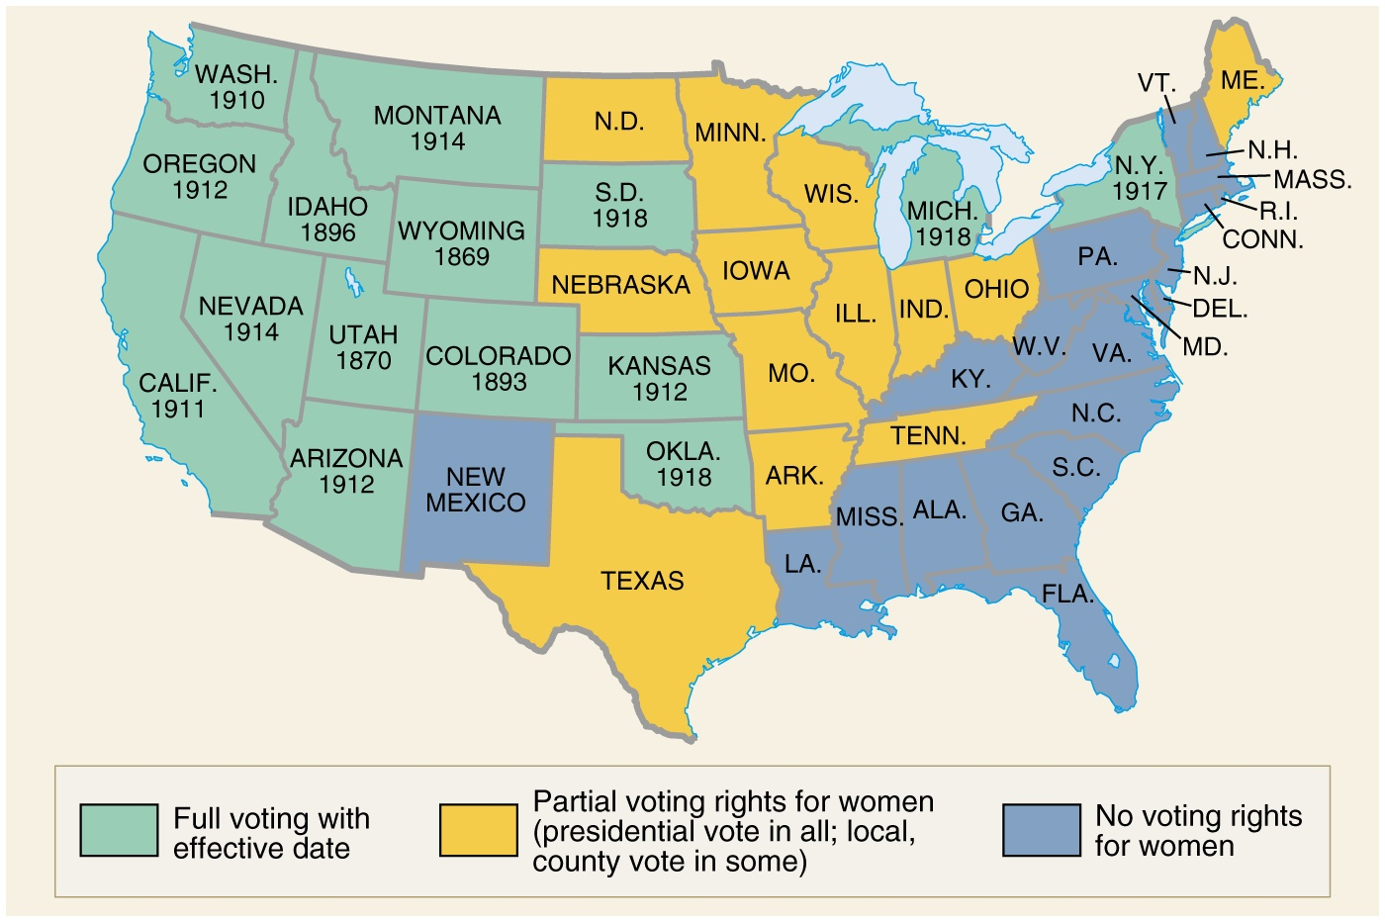
19th Amendment provides full suffrage to women in all the states, 1920.

Slide 19
WOMEN'S CHRISTIAN TEMPERANCE UNION
Founded in Cleveland, Ohio, in 1874, it used educational, social, and political means to promote legislation which dealt with issues ranging from health and hygiene, prison reform and world peace.
protection of women and children at home and work
women's right to vote
shelters for abused women
support from labor movements such as the Knights of Labor
the eight-hour work day
equal pay for equal work
founding of kindergartens
assistance in founding of the PTA
federal aid for education
stiffer penalties for sexual crimes against girls and women
uniform marriage and divorce laws

Slide 20
WOMEN'S CHRISTIAN TEMPERANCE UNION
Founded in Cleveland, Ohio, in 1874, it used educational, social, and political means to promote legislation which dealt with issues ranging from health and hygiene, prison reform and world peace.
protection of women and children at home and work
women's right to vote
shelters for abused women
support from labor movements such as the Knights of Labor
the eight-hour work day
equal pay for equal work
founding of kindergartens
assistance in founding of the PTA
federal aid for education
stiffer penalties for sexual crimes against girls and women
uniform marriage and divorce laws

Slide 21
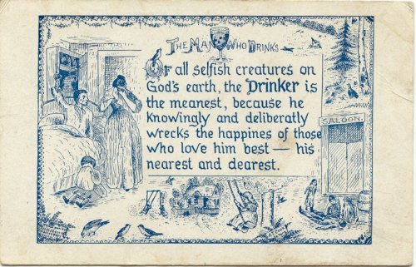
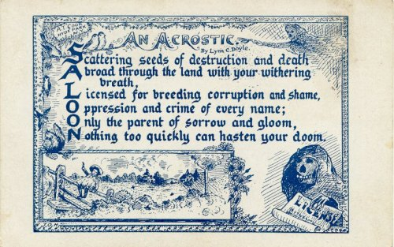
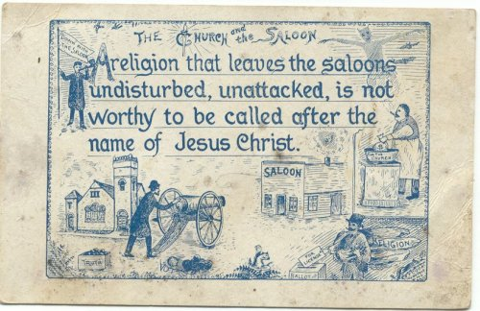
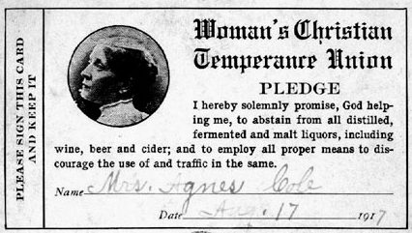
WOMEN'S CHRISTIAN TEMPERANCE UNION
Most successful work was in alerting the nation of the evils of alcohol and promoting legislation to outlaw it.
Passage of the 18th Amendment in 1919 to outlaw alcohol.

Slide 22
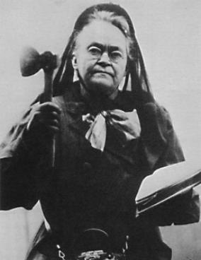
WOMEN'S CHRISTIAN TEMPERANCE UNION
Most successful and well known WCTU reformer was Carrie Nation.
She would march into a bar and sing and pray, while smashing bar fixtures and stock with a hatchet.

Slide 23
WOMEN'S CHRISTIAN TEMPERANCE UNION
Most successful and well known WCTU reformer was Carrie Nation.
She would march into a bar and sing and pray, while smashing bar fixtures and stock with a hatchet.

Slide 24
WOMEN'S CHRISTIAN TEMPERANCE UNION
Most successful and well known WCTU reformer was Carrie Nation.
She would march into a bar and sing and pray, while smashing bar fixtures and stock with a hatchet.

Slide 25
Progressive Era Federal Legislation
Hepburn Act (1906) Roosevelt
Strengthened the Interstate Commerce Commission, allowing it to set maximum railroad rates.
Federal Reserve Act (1913) Wilson
Created 12 district Federal Reserve Banks, each able to issue new currency and loan member banks funds at the prime interest rate, as established by the Federal Reserve Board.
Clayton Antitrust Act (1914) Wilson
Strengthened the Sherman Antitrust Act by outlawing the creation of a monopoly through any means, and stated that unions were not subject to antitrust legislation.
Federal Trade Act (1914) Wilson
Established the Federal Trade Commission, charged with investigating unfair business practices including monopolistic activity and inaccurate product labeling.

Slide 26
Wilson’s New Freedom
Underwood Tariff 1913 Wilson
Substantially reduced import fees and enacted a graduated income tax (under the approval of the recent 16th Amendment
Keating-Owen Act 1916 Wilson
Enacted by U.S. Congress which sought to address the perceived evils of child labor by prohibiting the sale in interstate commerce of goods manufactured by children. Signed into law by President Wilson. Act declared unconstitutional by the US Supreme Court

