Slide 1
Populist Parable/Wizard of OZ Youtube Clips

Slide 2
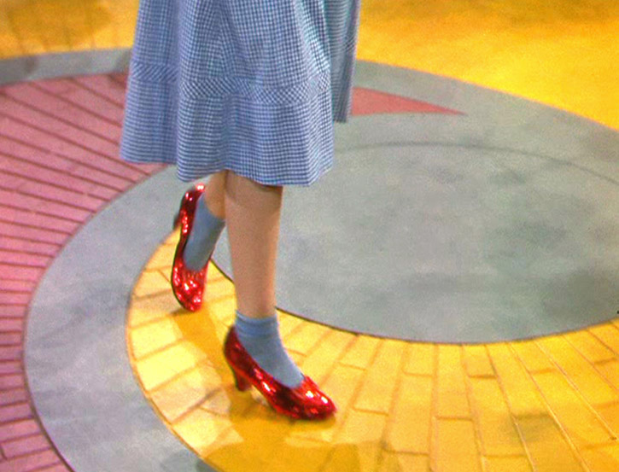
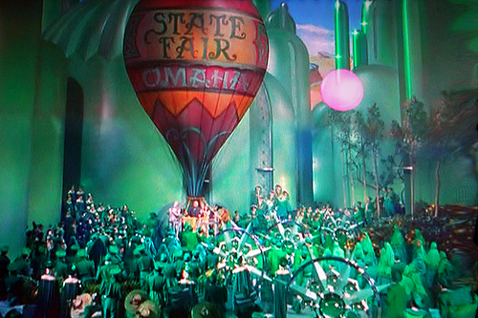
Connections…
Tin Man
Scarecrow
Cowardly Lion
The Wizard
Dorothy and her Silver Shoes (Red in the film)

