Slide 1
Machine Age/Gilded Age
Part #1

Slide 2
Captains of Industry/Monopolists/Robber Barons?
Andrew Carnegie
John D. Rockefeller
J.P. Morgan

Slide 3
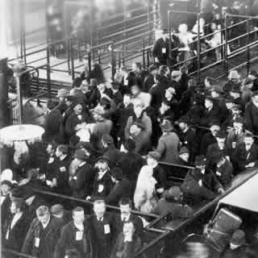
Causes of Rapid Industrialization
Unskilled & semi-skilled labor in abundance.
Abundant capital.
New, talented group of businessmen [entrepreneurs] and advisors.
Market growing as US population increased.
Government willing to help at all levels to stimulate economic growth.
Abundant natural resources.

Slide 4
Causes of Rapid Industrialization
Technological innovations.
Bessemer and open hearth process
Refrigerated cars
Edison
“Wizard of Menlo Park”
light bulb, phonograph, motion pictures.

Slide 5
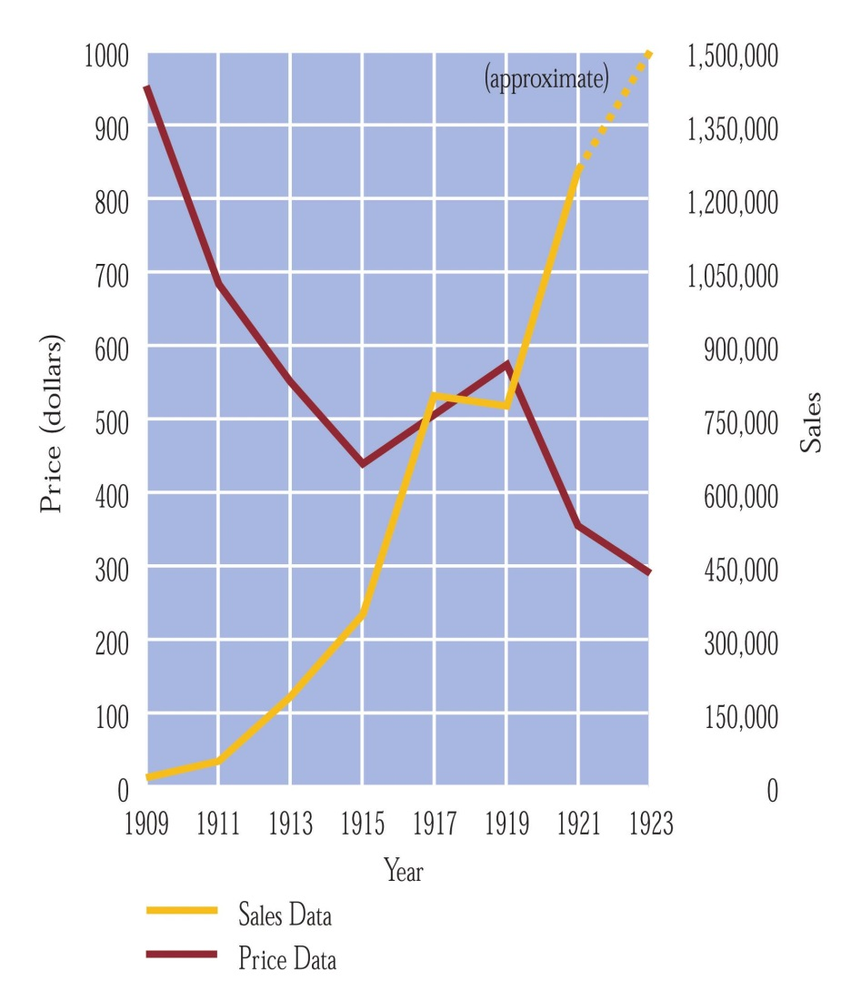
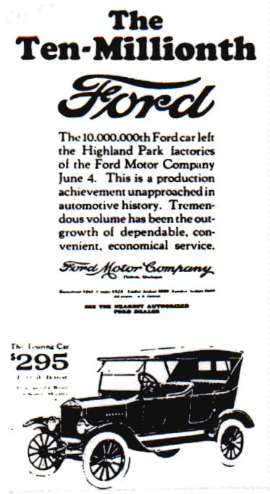
“Model T” Prices & Sales

Slide 6
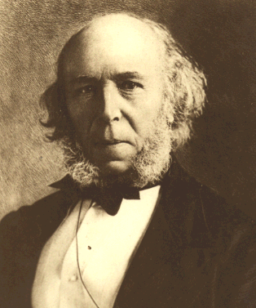
2. Social Darwinism
British economist.
Advocate of laissez-faire.
Adapted Darwin’s ideas from the “Origin of Species” to humans.
Notion of “Survival of the Fittest.”
Herbert Spencer

Slide 7
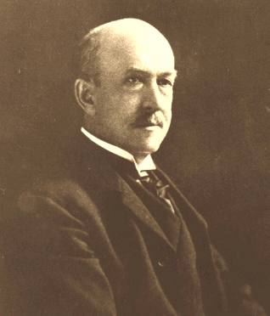
2. Social Darwinism in America
Individuals must have absolute freedom to struggle, succeed or fail.
Therefore, state intervention to reward society and the economy is futile!
William Graham Sumner Folkways (1906)

Slide 8
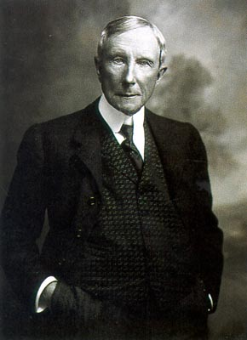
New Type of Business Entities
Pool 1887→ Interstate Commerce Act → Interstate Commerce Commission created.
Trust → John D. Rockefeller
Standard Oil Co.

Slide 9
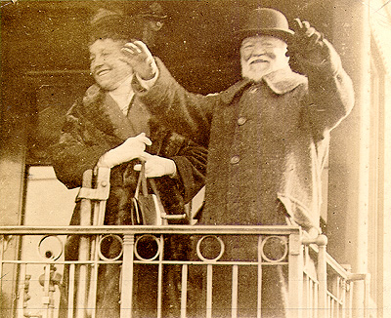
New Type of Business Entities
Trust:
Horizontal Integration → John D. Rockefeller
Vertical Integration:
Gustavus Swift → Meat-packing
Andrew Carnegie → U. S. Steel

Slide 10
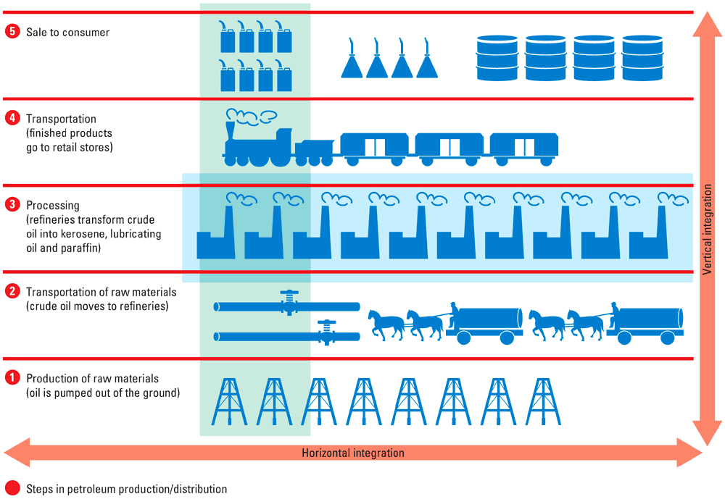
New Type of Business Entities

