Slide 1
The Growth
of the
American
Labor Movement
Ms. Susan M. Pojer Horace Greeley HS Chappaqua, NY

Slide 2
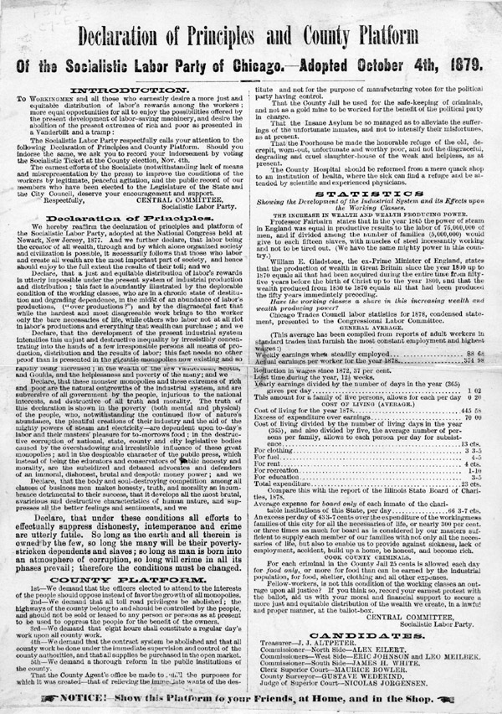
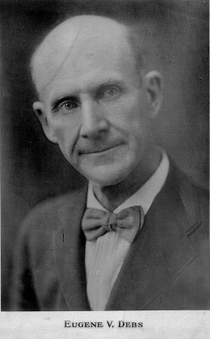
The Socialists
Eugene V. Debs

Slide 3
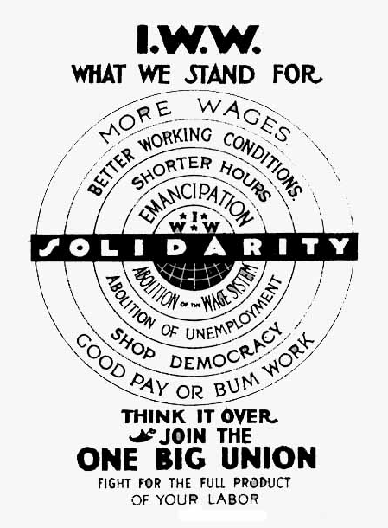
International Workers of the World (“Wobblies”)

Slide 4
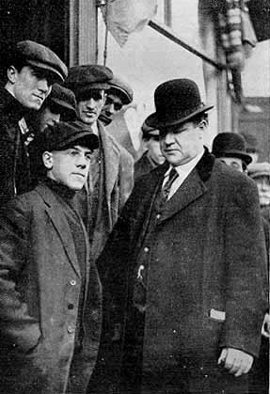
“Big Bill” Haywood of the IWW
Violence was justified to overthrow capitalism.

Slide 5
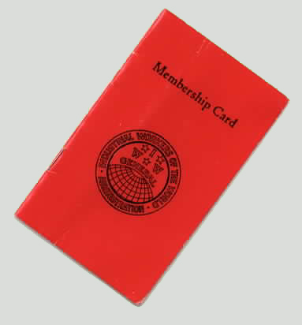
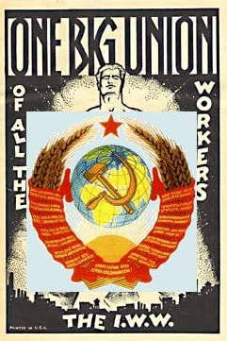
I W W & the Internationale

Slide 6
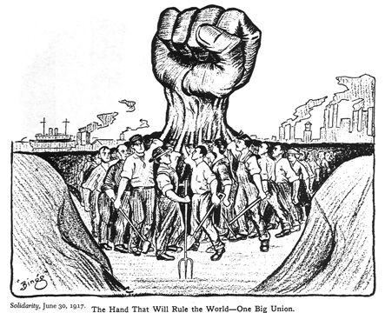
The Hand That Will Rule the World→ One Big Union

Slide 7
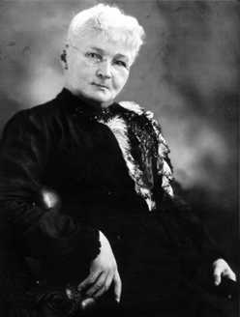
Mother Jones: “The Miner’s Angel”
Mary Harris.
Organizer for the United Mine Workers.
Founded the Social Democratic Party in 1898.
One of the founding members of the I. W. W. in 1905.

Slide 8
The “Bread & Roses” Strike
DEMANDS:
15¢/hr. wage increase.
Double pay for overtime.
No discrimination against strikers.
An end to “speed-up” on the assembly line.
An end to discrimination against foreign immigrant workers.

Slide 9
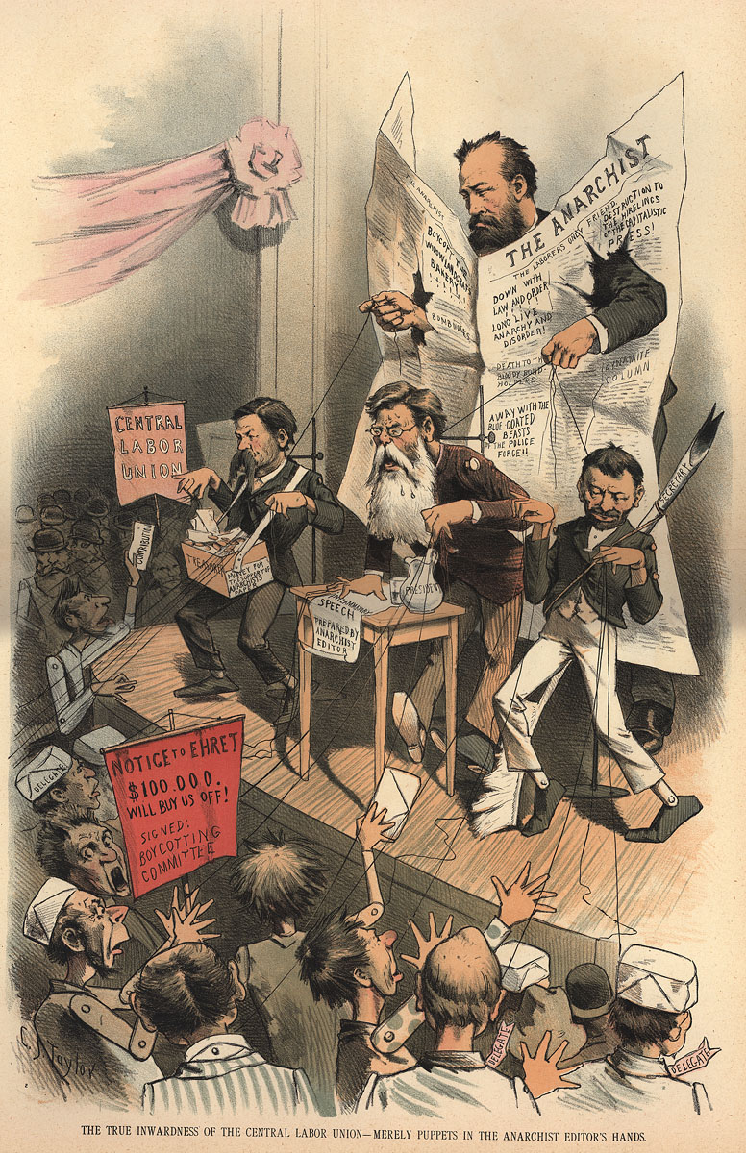
The “Formula”
unions + violence + strikes + socialists + immigrants = anarchists

Slide 10
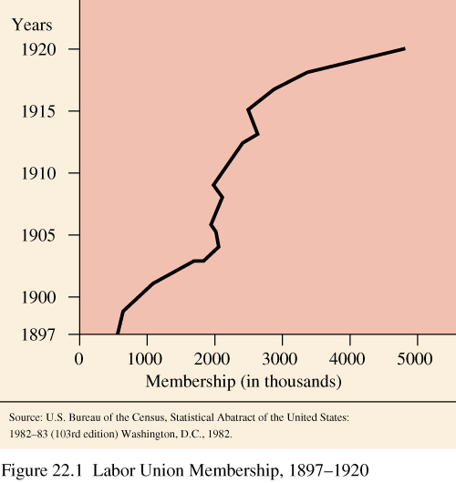
Labor Union Membership

Slide 11
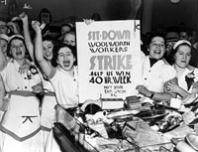
“Solidarity Forever!” by Ralph Chapin (1915)
When the union's inspiration through the workers‘ blood shall run, There can be no power greater anywhere beneath the sun; Yet what force on earth is weaker than the feeble strength of one, But the union makes us strong!
CHORUS: Solidarity forever, Solidarity forever, Solidarity forever, For the union makes us strong!

Slide 12
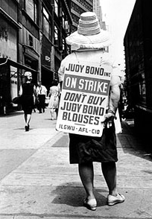
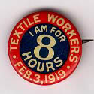
Come On and Sing Along!!

Slide 13
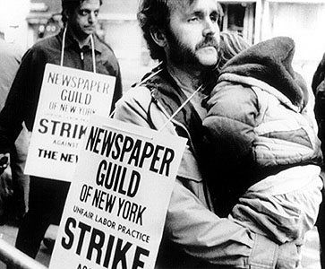
“Solidarity Forever!”
Is there aught we hold in common with the greedy parasite, Who would lash us into serfdom and would crush us with his might? Is there anything left to us but to organize and fight? For the union makes us strong!
CHORUS: Solidarity forever, Solidarity forever, Solidarity forever, For the union makes us strong!

Slide 14
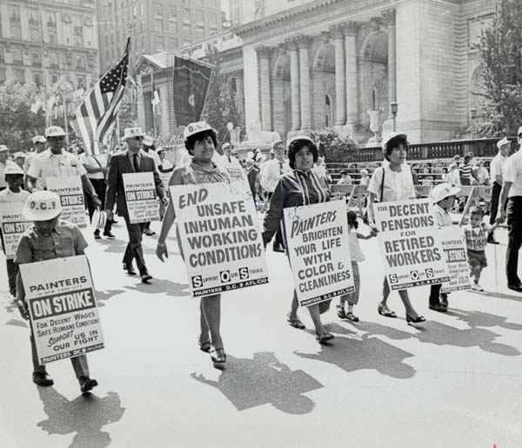
“Solidarity Forever!”
* * * * Through our sisters and our brothers we can make our union strong, For respect and equal value, we have done without too long. We no longer have to tolerate injustices and wrongs, Yes, the union makes us strong!
CHORUS: Solidarity forever, Solidarity forever, Solidarity forever, For the union makes us strong!

Slide 15
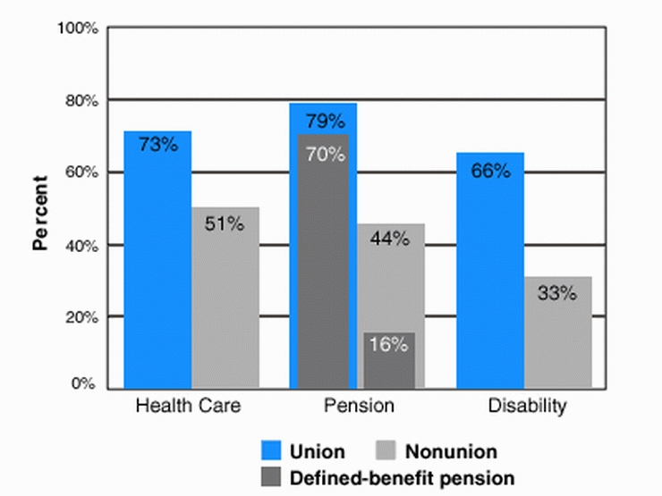
Workers Benefits Today

Slide 16
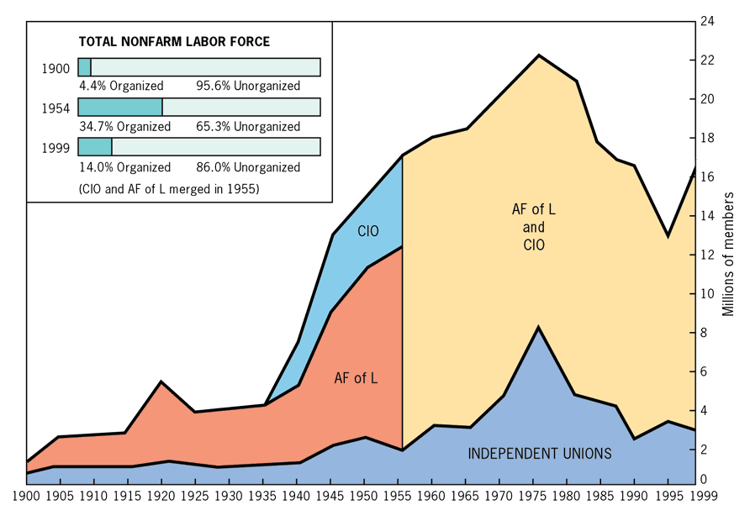
The Rise & Decline of Organized Labor

Slide 17
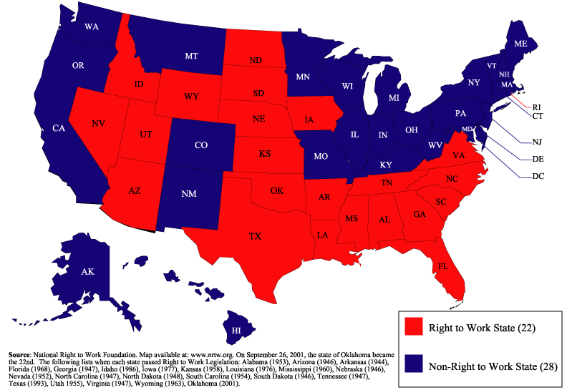
Right-to-Work States Today

Slide 18
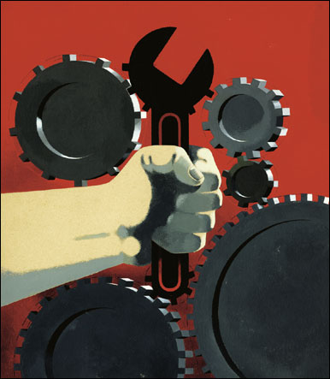
Unionism & Globalization?

