Slide 1
The Growth
of the
American
Labor Movement
Ms. Susan M. Pojer Horace Greeley HS Chappaqua, NY

Slide 2
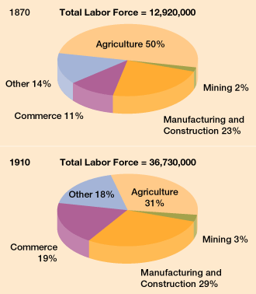
The Changing American Labor Force

Slide 3
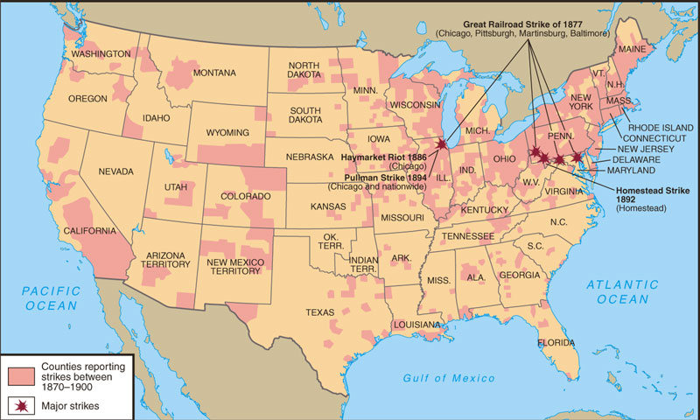
Labor Unrest: 1870-1900

Slide 4
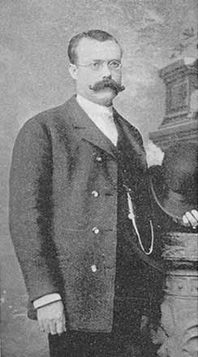
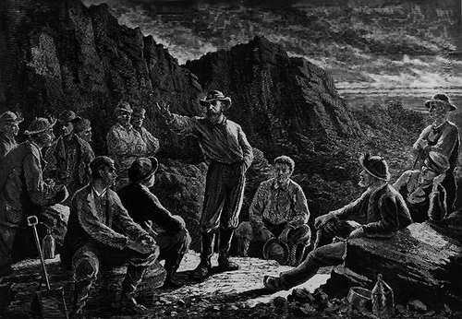
The Molly Maguires (1875)
James McParland

Slide 5
Management vs. Labor
“Tools” of Management
“Tools” of Labor
“scabs”
P. R. campaign
Pinkertons
lockout
blacklisting
yellow-dog contracts
court injunctions
open shop
boycotts
sympathy demonstrations
informational picketing
closed shops
organized strikes
“wildcat” strikes

Slide 6
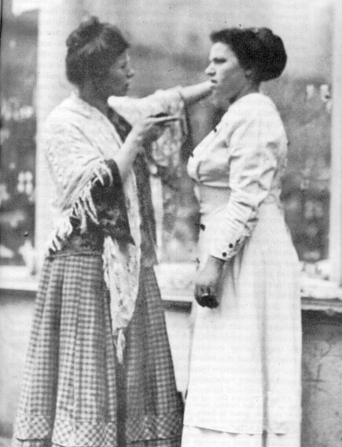
A Striker Confronts a SCAB!

Slide 7
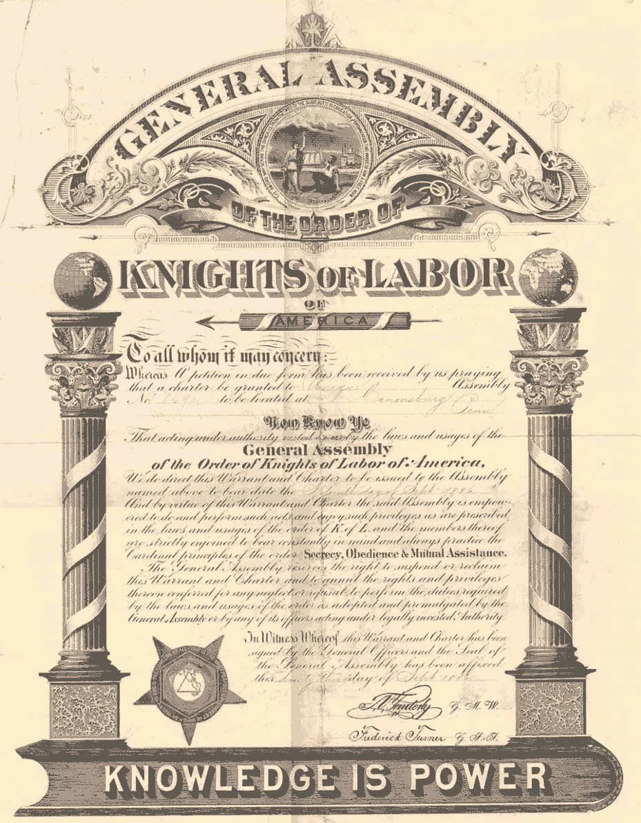
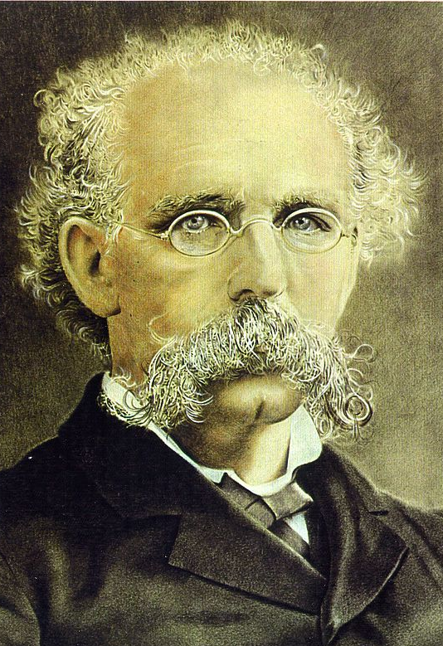
Knights of Labor
Terence V. Powderly
An injury to one is the concern of all!

Slide 8
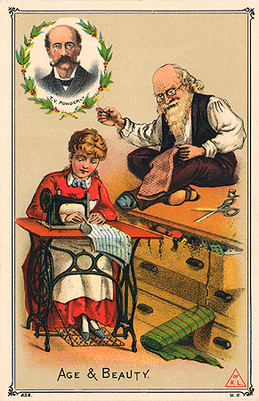
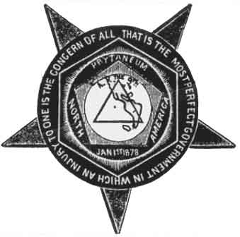
Knights of Labor
Knights of Labor trade card

Slide 9
Goals of the Knights of Labor
Eight-hour workday.
Workers’ cooperatives.
Worker-owned factories.
Abolition of child and prison labor.
Increased circulation of greenbacks.
Equal pay for men and women.
Safety codes in the workplace.
Prohibition of contract foreign labor.
Abolition of the National Bank.

Slide 10
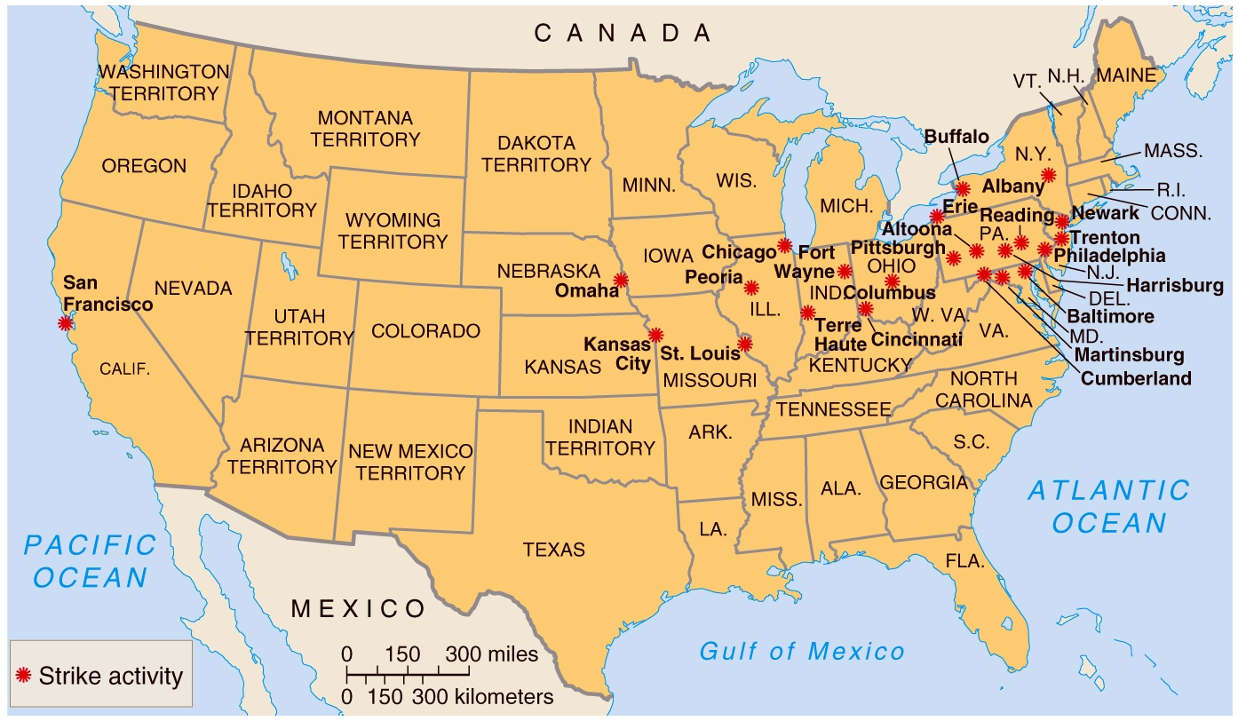
The Great Railroad Strike of 1877

Slide 11
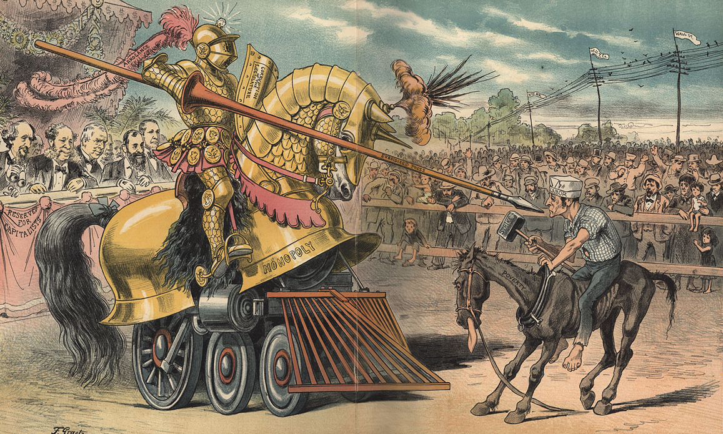
The Tournament of Today: A Set-to Between Labor and Monopoly

Slide 12
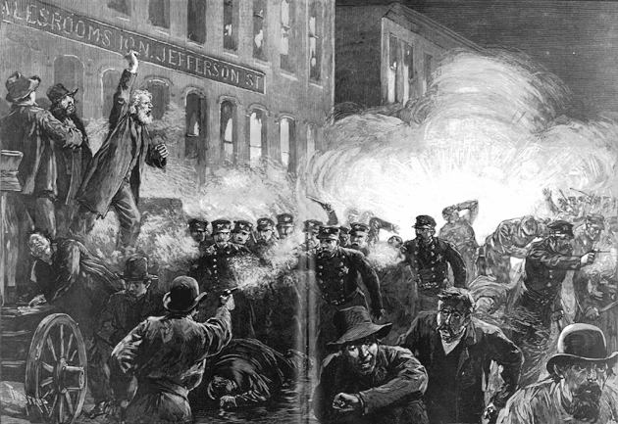
Haymarket Riot (1886)
McCormick Harvesting Machine Co.

Slide 13
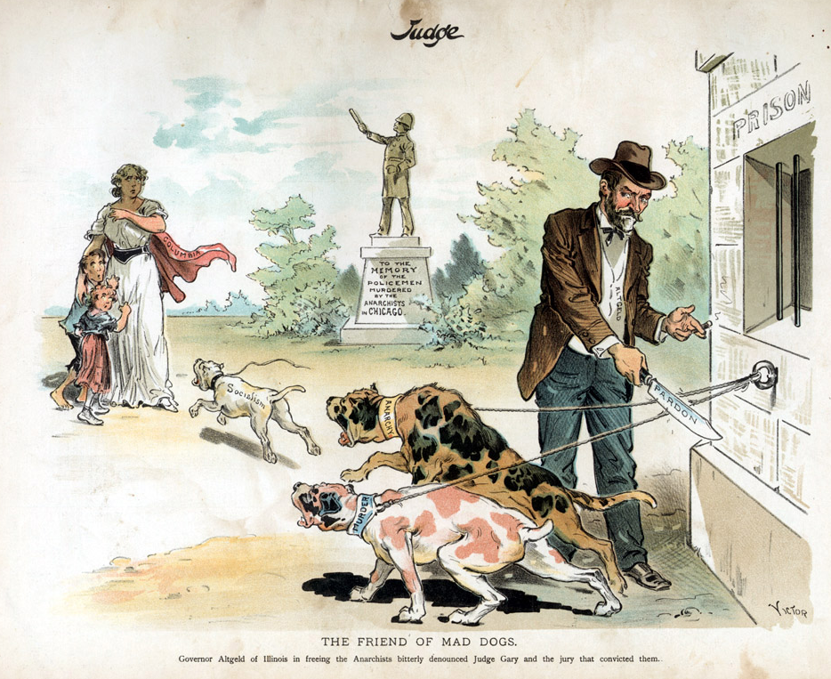
Governor John Peter Altgeld

Slide 14
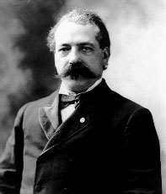
The American Federation of Labor: 1886
Samuel Gompers

Slide 15
How the AF of L Would Help the Workers
Catered to the skilled worker.
Represented workers in matters of national legislation.
Maintained a national strike fund.
Evangelized the cause of unionism.
Prevented disputes among the many craft unions.
Mediated disputes between management and labor.
Pushed for closed shops.

Slide 16
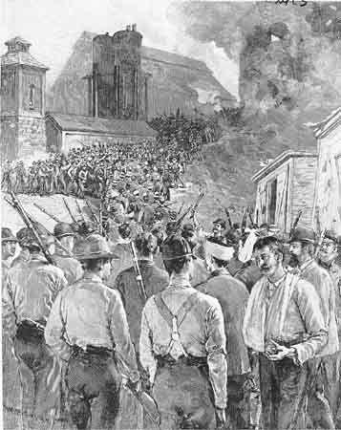
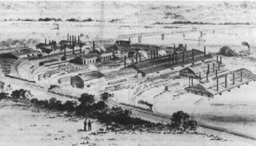
Homestead Steel Strike (1892)
Homestead Steel Works
The Amalgamated Association of Iron & Steel Workers

Slide 17
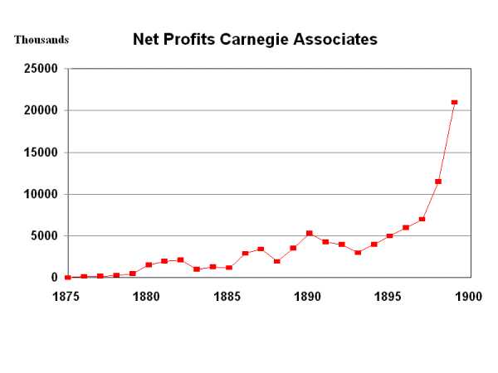
Big Corporate Profits!

Slide 18
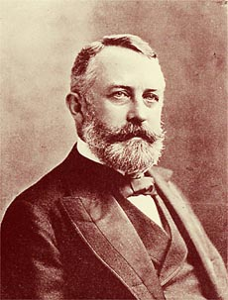
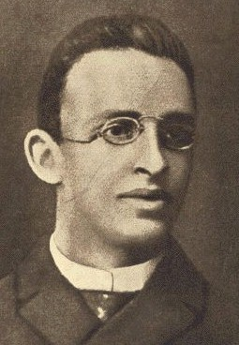
Attempted Assassination!
Henry Clay Frick
Alexander Berkman

Slide 19
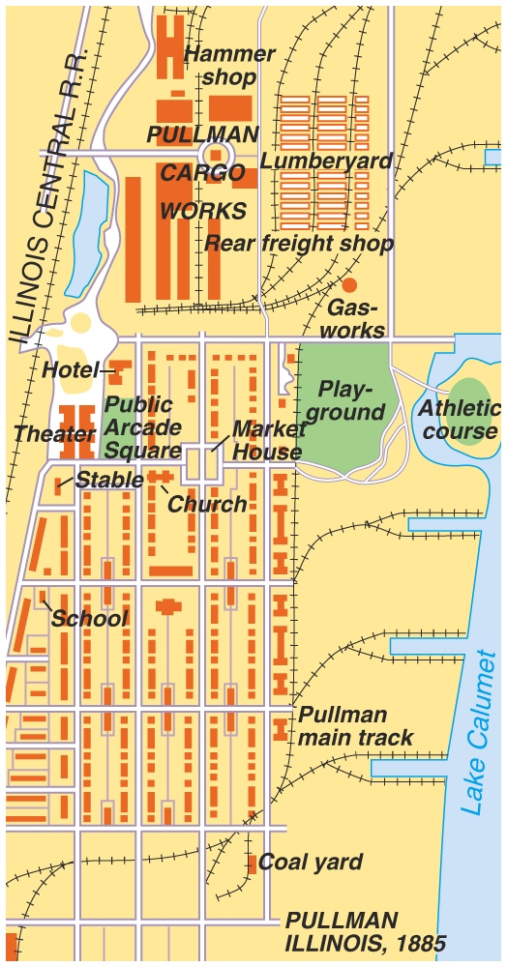
A “Company Town”:
Pullman, IL

Slide 20
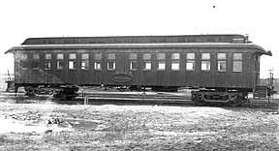
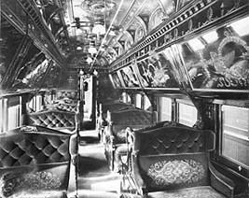
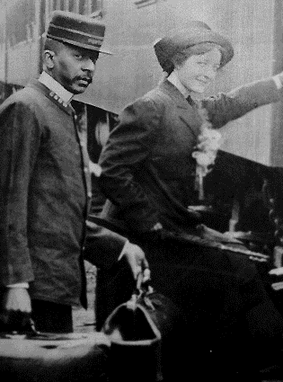
Pullman Cars
A Pullman porter

Slide 21
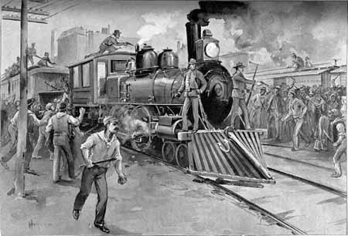
The Pullman Strike of 1894

