Slide 1
America
Becomes
a Colonial
Power
Ms. Susan M. Pojer Horace Greeley HS Chappaqua, NY

Slide 2
Why did America
join the imperialist
club at the end
of the 19c?

Slide 3
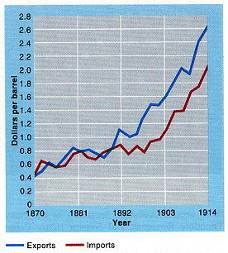
1. Commercial/Business Interests
American Foreign Trade: 1870-1914

Slide 4
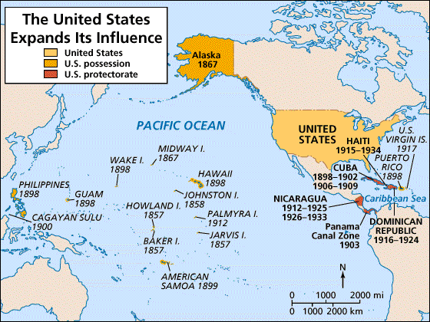
2. Military/Strategic Interests
Alfred T. Mahan → The Influence of Sea Power on History: 1660-1783

Slide 5
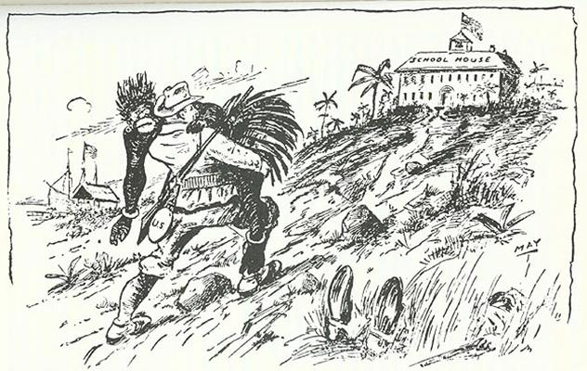
3. Social Darwinist Thinking
The White Man’s Burden
The Hierarchy of Race

Slide 6
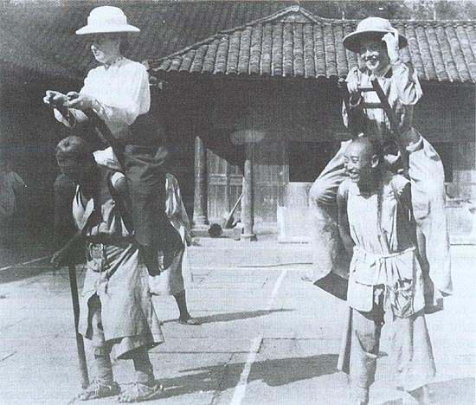
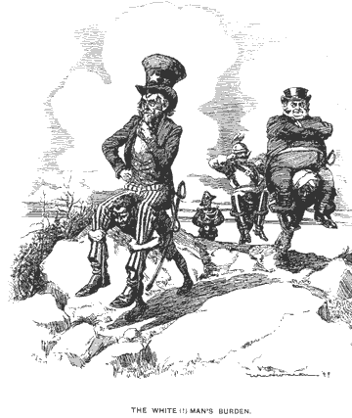
4. Religious/Missionary Interests
American Missionaries in China, 1905

Slide 7
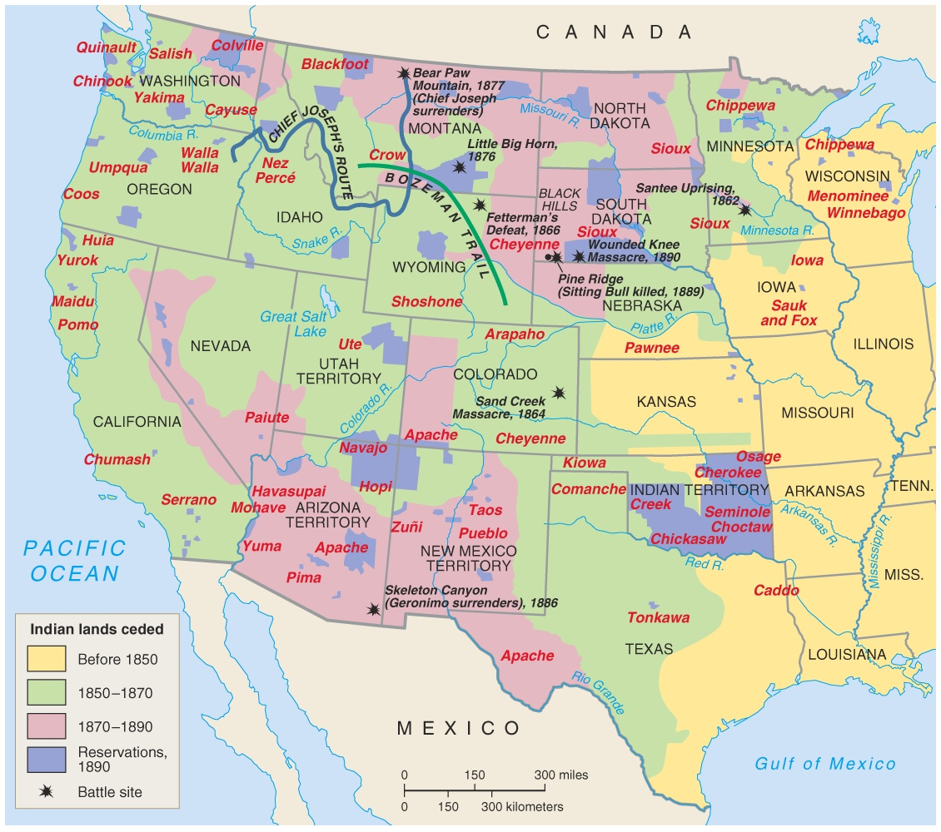
5. Closing the American Frontier

Slide 8
Hawaii:
"Crossroads
of the
Pacific"

Slide 9
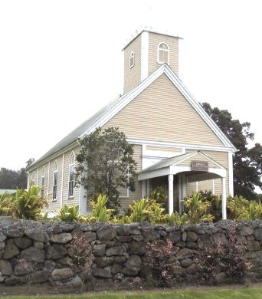
U. S. Missionaries in Hawaii
Imiola Church – first built in the late 1820s

Slide 10
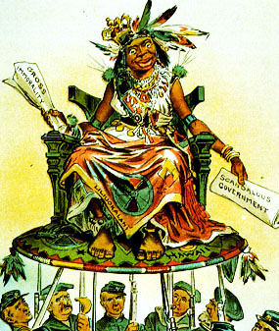
U. S. View of Hawaiians
Hawaii becomes a U. S. Protectorate in 1849 by virtue of economic treaties.

Slide 11
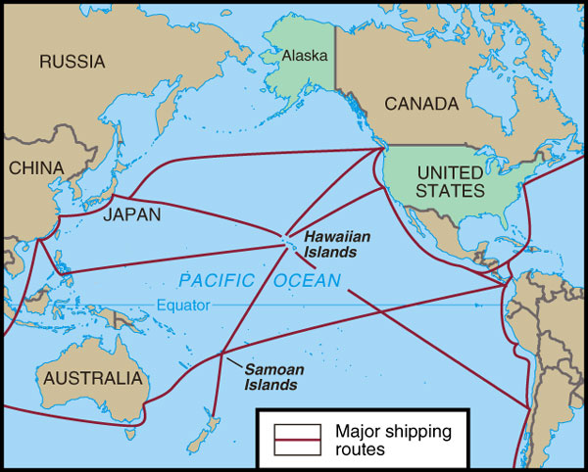
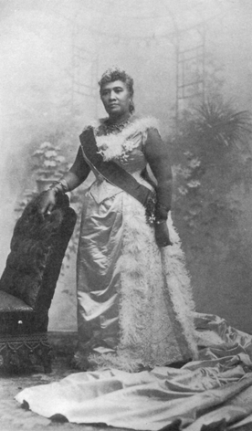
Hawaiian Queen Liliuokalani
Hawaii for the Hawaiians!

Slide 12
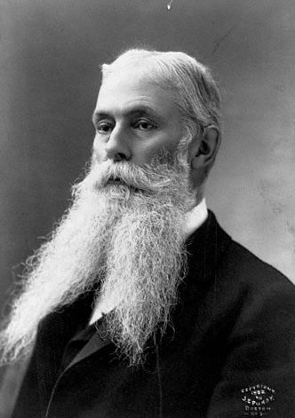
U. S. Business Interests In Hawaii
1875 – Reciprocity Treaty
1890 – McKinley Tariff
1893 – American businessmen backed an uprising against Queen Liliuokalani.
Sanford Ballard Dole proclaims the Republic of Hawaii in 1894.

Slide 13
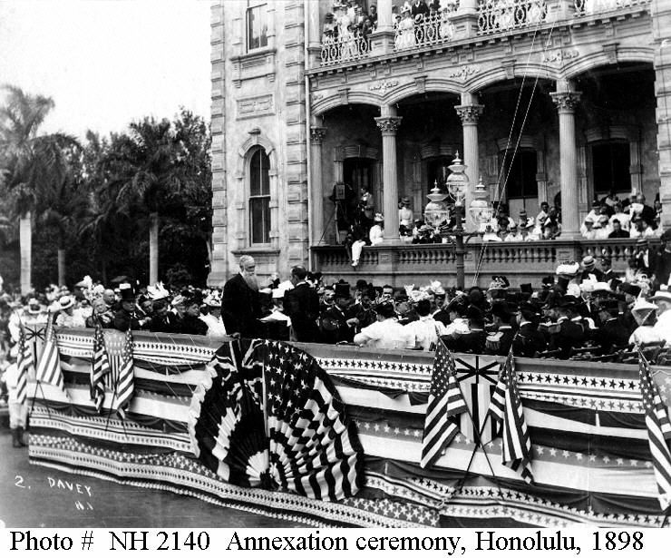
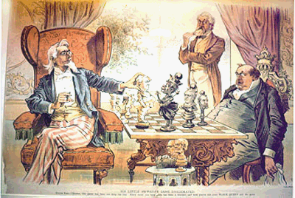
To The Victor Belongs the Spoils
Hawaiian Annexation Ceremony, 1898

Slide 14
Japan

Slide 15
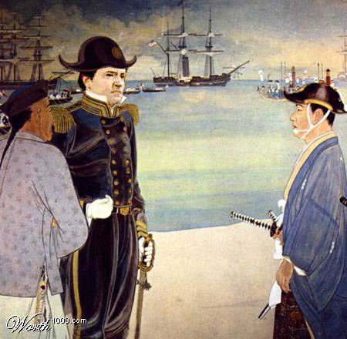
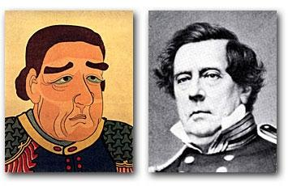
Commodore Matthew Perry Opens Up Japan: 1853
The Japanese View of Commodore Perry

Slide 16
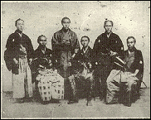
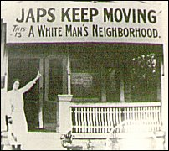
Gentleman’s Agreement: 1908
A Japanese note agreeing to deny passports to laborers entering the U.S.
Japan recognized the U.S. right to exclude Japanese immigrants holding passports issued by other countries.
The U.S. government got the school board of San Francisco to rescind their order to segregate Asians in separate schools.
1908 → Root-Takahira Agreement.

Slide 17
Alaska

Slide 18
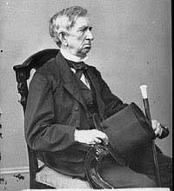
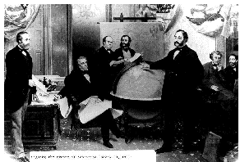
“Seward’s Folly”: 1867
$7.2 million

Slide 19
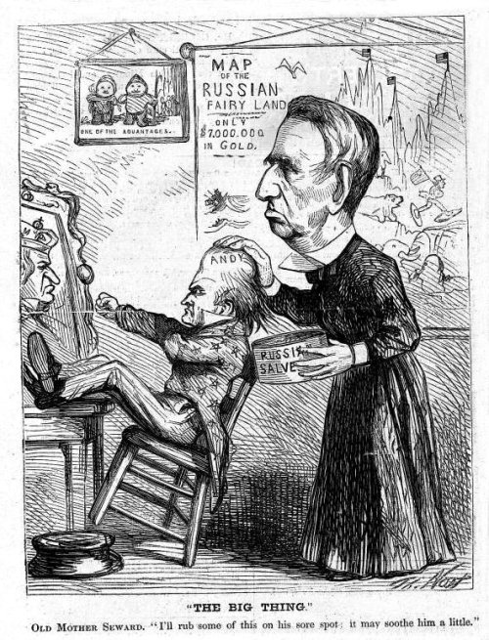
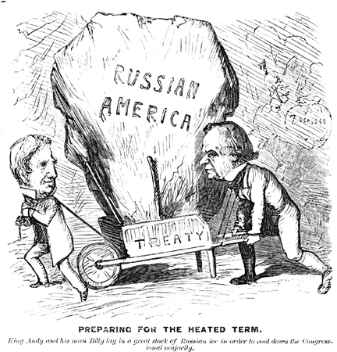
“Seward’s Icebox”: 1867

Slide 20
Cuba

Slide 21
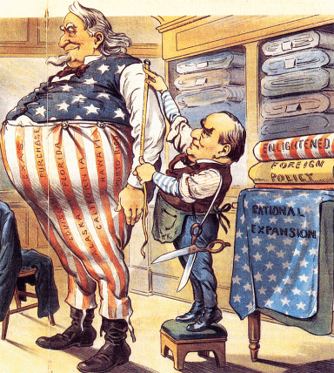
The Imperialist Tailor

Slide 22
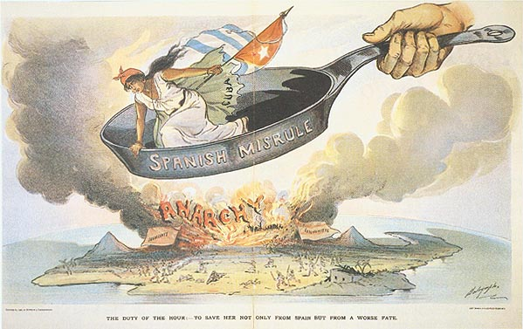
Spanish Misrule in Cuba

Slide 23
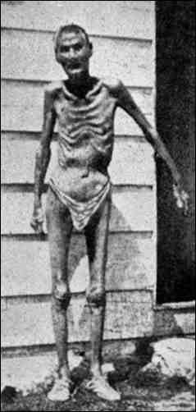
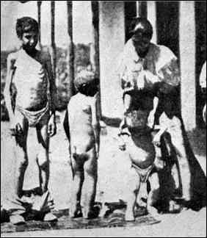
Valeriano Weyler’s “Reconcentration” Policy

Slide 24
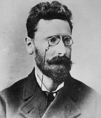
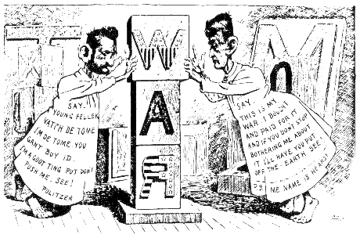
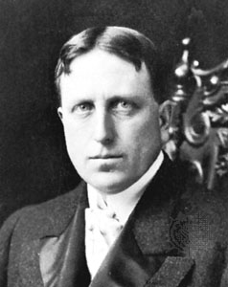
“Yellow Journalism” & Jingoism
Joseph Pulitzer
Hearst to Frederick Remington: You furnish the pictures, and I’ll furnish the war!
William Randolph Hearst

Slide 25
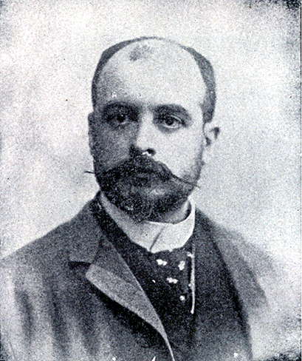
De Lôme Letter
Dupuy de Lôme, Spanish Ambassador to the U.S.
Criticized President McKinley as weak and a bidder for the admiration of the crowd, besides being a would-be politician who tries to leave a door open behind himself while keeping on good terms with the jingoes of his party.

Slide 26
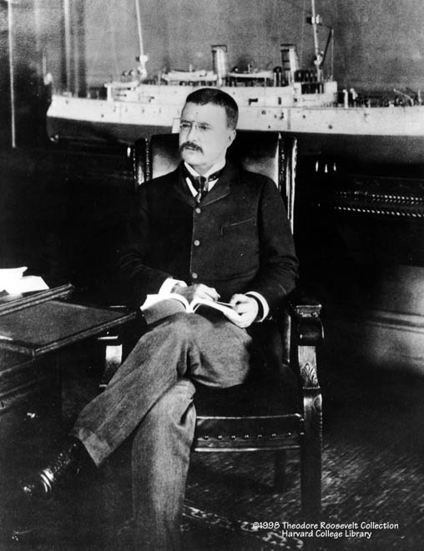
Theodore Roosevelt
Assistant Secretary of the Navy in the McKinley administration.
Imperialist and American nationalist.
Criticized President McKinley as having the backbone of a chocolate éclair!
Resigns his position to fight in Cuba.

Slide 27
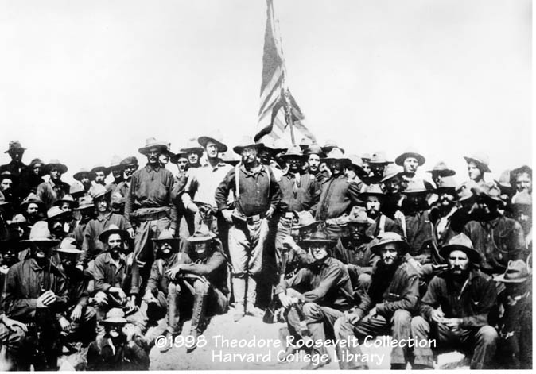
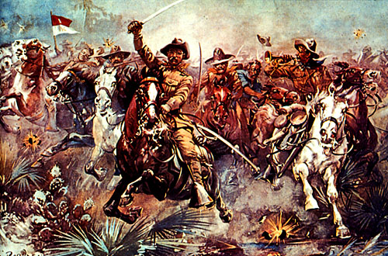
The “Rough Riders”

Slide 28
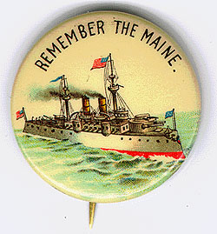
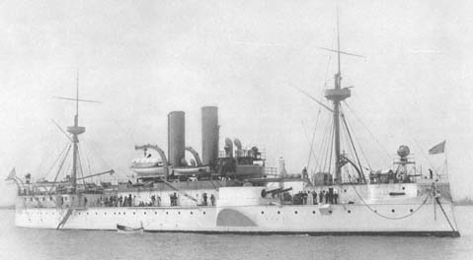
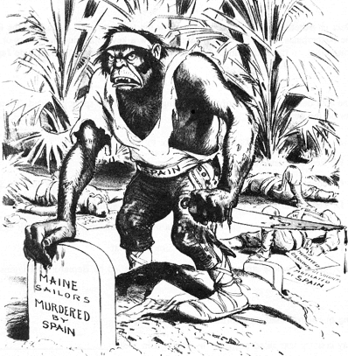
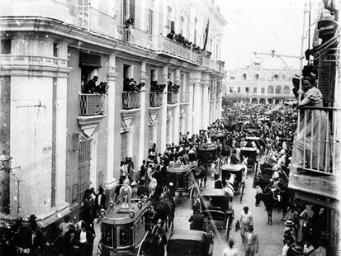
Remember the Maine and to Hell with Spain!
Funeral for Maine victims in Havana

Slide 29
The Spanish-American War (1898): “That Splendid Little War”

Slide 30
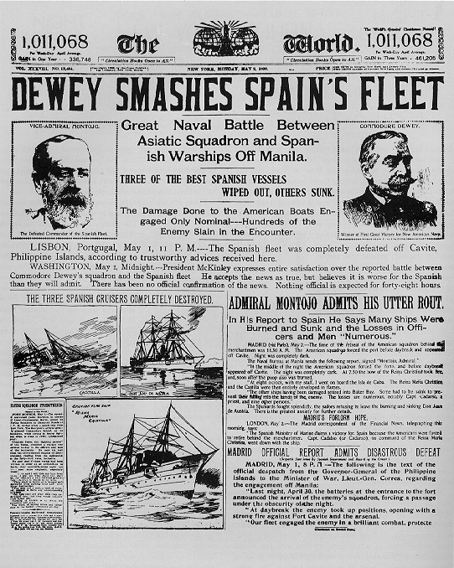
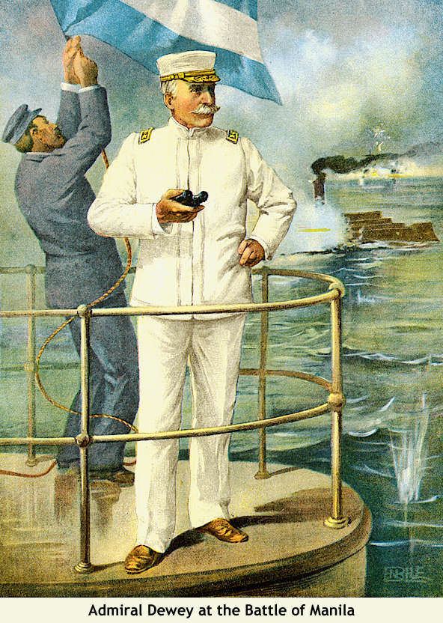
Dewey Captures Manila!

Slide 31
The Spanish-American War (1898): “That Splendid Little War”
How prepared was the US for war?

Slide 32
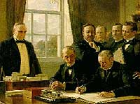
The Treaty of Paris: 1898
Cuba was freed from Spanish rule.
Spain gave up Puerto Rico and the island of Guam.
The U. S. paid Spain $20 mil. for the Philippines.
The U. S. becomes an imperial power!

Slide 33
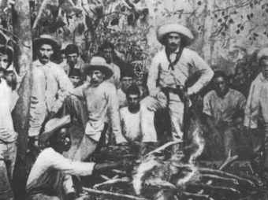
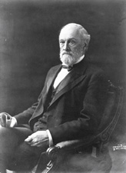
Cuban Independence?
Teller Amendment (1898)
Platt Amendment (1903)
Cuba was not to enter into any agreements with foreign powers that would endanger its independence.
The U.S. could intervene in Cuban affairs if necessary to maintain an efficient, independent govt.
Cuba must lease Guantanamo Bay to the U.S. for naval and coaling station.
Cuba must not build up an excessive public debt.
Senator Orville Platt

Slide 34
The
Philippines

Slide 35
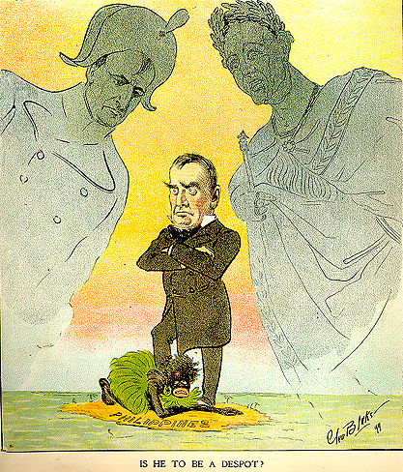
Is He To Be a Despot?

Slide 36
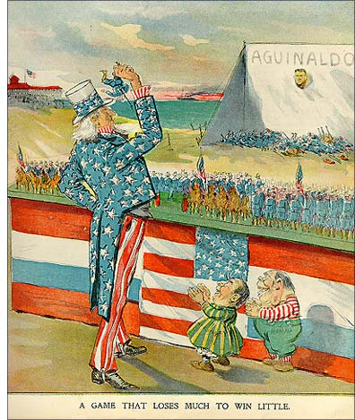
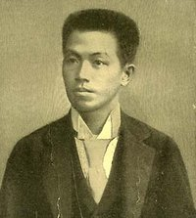
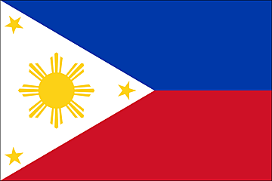
Emilio Aguinaldo
Leader of the Filipino Uprising.
July 4, 1946: Philippine independence

Slide 37
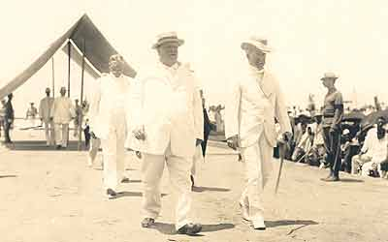
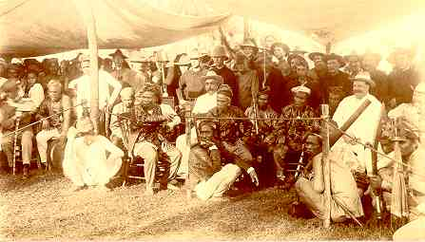
William H. Taft, 1st Gov.-General of the Philippines
Great administrator.

Slide 38
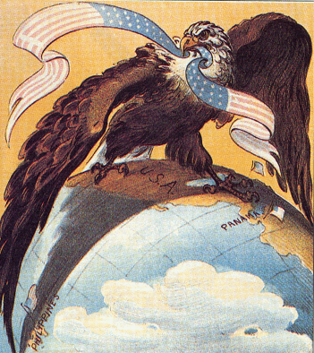
Our “Sphere of Influence”

Slide 39
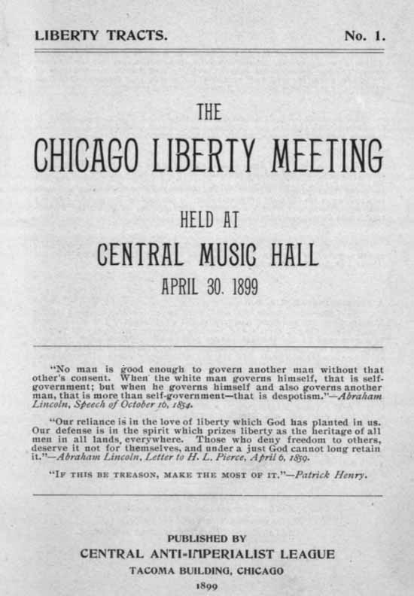
The American Anti-Imperialist League
Founded in 1899.
Mark Twain, Andrew Carnegie, William James, and William Jennings Bryan among the leaders.
Campaigned against the annexation of the Philippines and other acts of imperialism.

Slide 40
Puerto
Rico

Slide 41
Puerto Rico: 1898
1900 - Foraker Act.
PR became an “unincorporated territory.”
Citizens of PR, not of the US.
Import duties on PR goods
1901-1903 → the Insular Cases.
Constitutional rights were not automatically extended to territorial possessions.
Congress had the power to decide these rights.
Import duties laid down by the Foraker Act were legal!

Slide 42
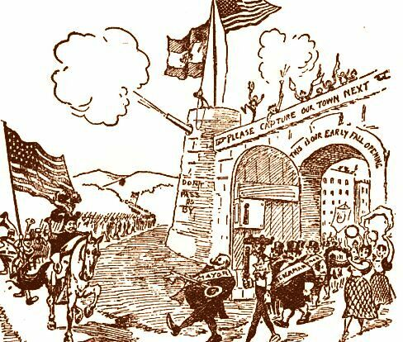
Puerto Rico: 1898
1917 – Jones Act.
Gave full territorial status to PR.
Removed tariff duties on PR goods coming into the US.
PRs elected their own legislators & governor to enforce local laws.
PRs could NOT vote in US presidential elections.
A resident commissioner was sent to Washington to vote for PR in the House.

Slide 43
Panama

Slide 44
Panama Canal
TR in Panama (Construction begins in 1904)

Slide 45
The Roosevelt Corollary to the Monroe Doctrine: 1905
Chronic wrongdoing… may in America, as elsewhere, ultimately require intervention by some civilized nation, and in the Western Hemisphere the adherence of the United States to the Monroe Doctrine may force the United States, however reluctantly, in flagrant cases of such wrongdoing or impotence, to the exercise of an international police power .

Slide 46
Speak Softly, But Carry a Big Stick!

Slide 47
China

Slide 48
Stereotypes of the Chinese Immigrant
Oriental [Chinese] Exclusion Act, 1887

Slide 49
The Boxer Rebellion: 1900
The Peaceful Harmonious Fists.
“55 Days at Peking.”

Slide 50
The Open Door Policy
Secretary John Hay.
Give all nations equal access to trade in China.
Guaranteed that China would NOT be taken over by any one foreign power.

Slide 51
Constable of the World

