Slide 1
Gilded Age/Machine Age
Part #3

Slide 2
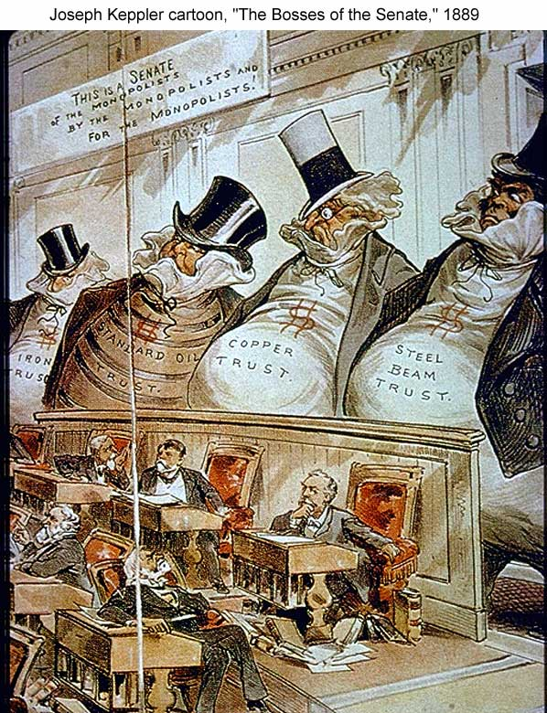
The ‘Bosses’ of the Senate

Slide 3
Regulating the Trusts
1877 → Munn. v. IL
1886 → Wabash, St. Louis & Pacific Railroad Company v. IL
1890 → Sherman Antitrust Act
in “restraint of trade”
“rule of reason” loophole
1895 → US v. E. C. Knight Co.

Slide 4
The Gospel of Wealth: Religion in the Era of Industrialization
Wealth no longer looked upon as bad.
Viewed as a sign of God’s approval.
Christian duty to accumulate wealth.
Should not help the poor.
Russell H. Conwell

Slide 5
“On Wealth”
The Anglo-Saxon race is superior.
“Gospel of Wealth” (1901).
Inequality is inevitable and good.
Wealthy should act as “trustees” for their “poorer brethren.”
Andrew Carnegie

Slide 6
Gospel of Wealth Excerpts
http://www.fordham.edu/HALSAll/MOD/1889carnegie.asp
http://historymatters.gmu.edu/d/5767/

