Slide 1
Gilded Age/Machine Age
Part #2

Slide 2
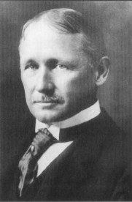
The Reorganization of Work
Frederick W. Taylor
The Principles of Scientific Management (1911)

Slide 3
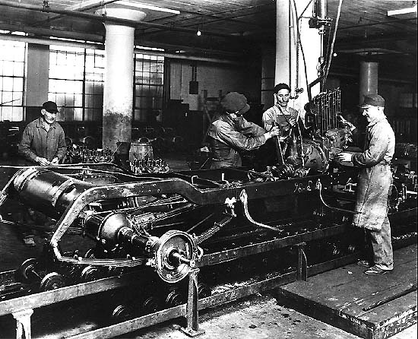
The Reorganization of Work
The Assembly Line

Slide 4
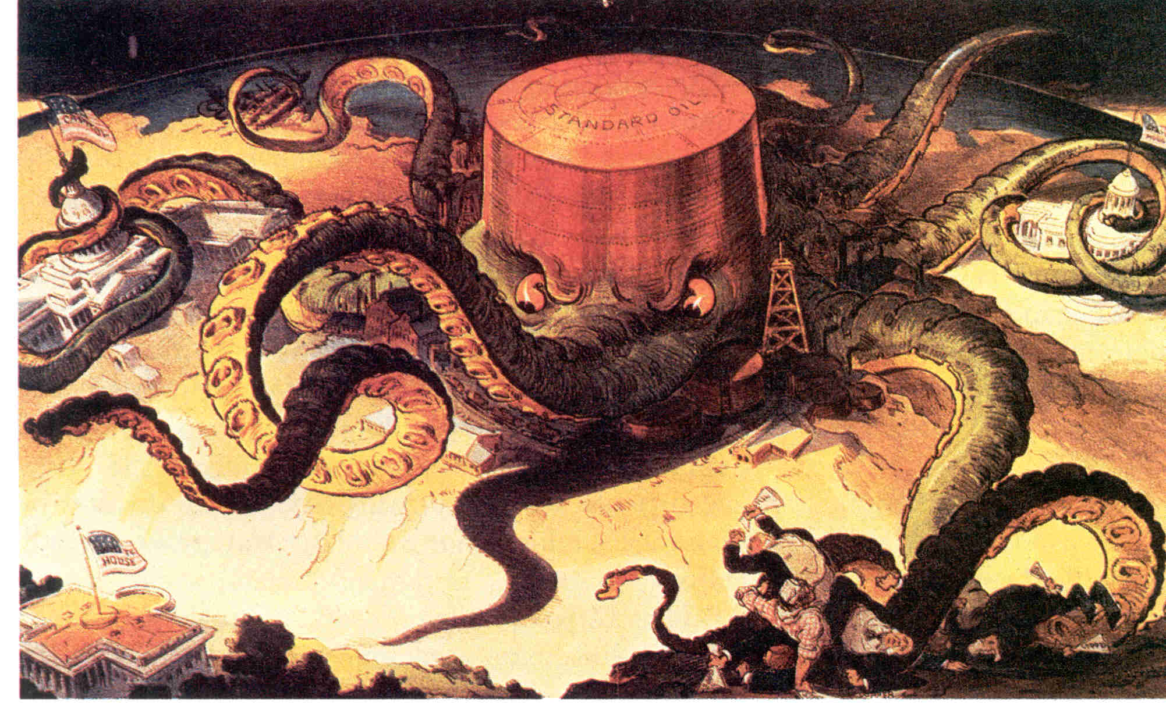
Standard Oil Co.

Slide 5
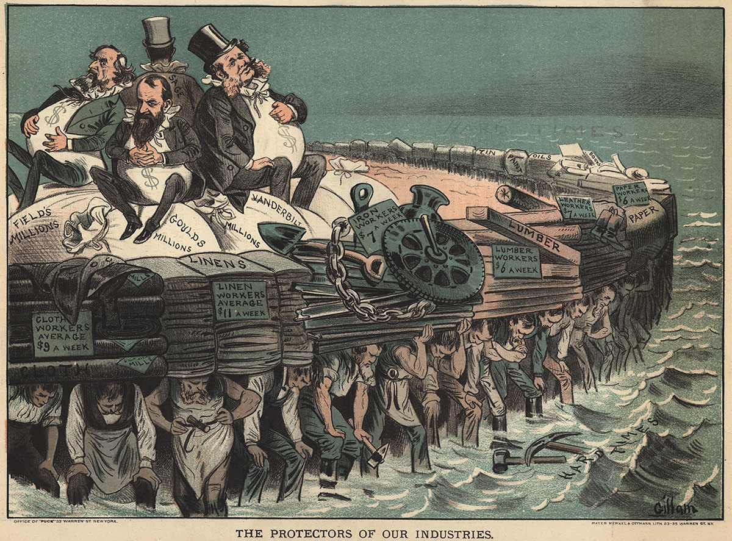
The Protectors of Our Industries

Slide 6
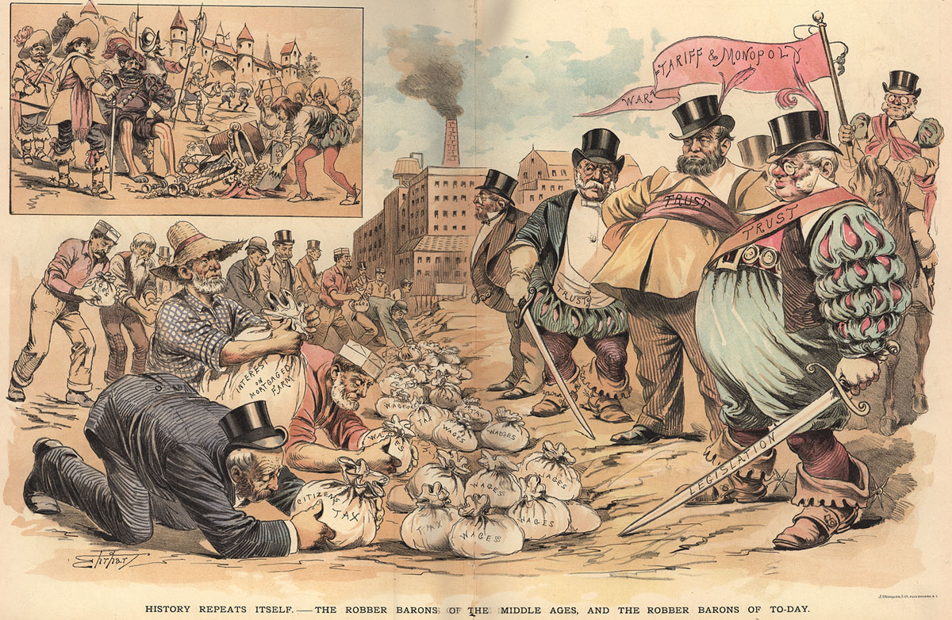
The ‘Robber Barons’ of the Past

