Slide 1
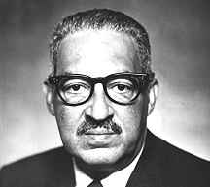
Thurgood Marshall
May 1954: Brown vs. Board of Education Topeka

Slide 2
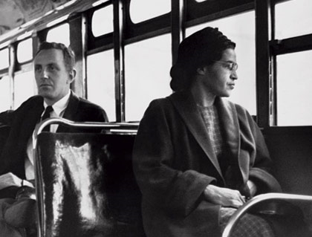
Rosa Parks

Slide 3
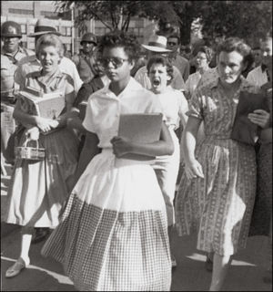
1957: Crisis in Little Rock

Slide 4
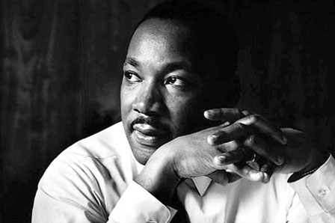
Martin Luther King Jr.

Slide 5
“There comes a time when people get tired of being trampled over by the iron feet of oppression…I want it to be known—that we’re going to work with grim and bold determination—to gain justice on buses in this city. And we are not wrong…if we are wrong—the Supreme Court of this nation is wrong. If we are wrong—God Almighty is wrong…if we are wrong justice is a lie.”
Dr. Martin Luther King Jr.

Slide 6
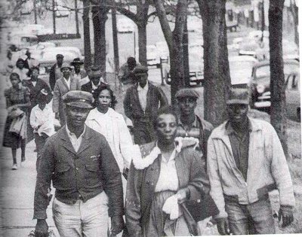
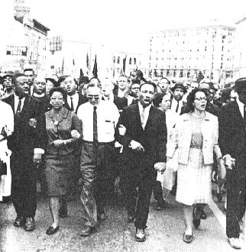
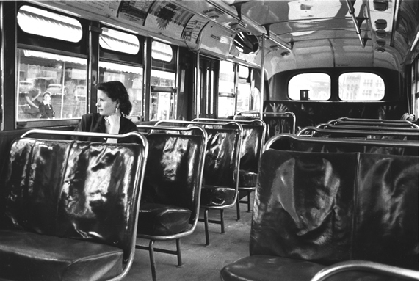

Slide 7
“We will not hate you, but we cannot…obey your unjust laws…We will soon wear you down by our capacity to suffer. And in winning our freedom, we will so appeal to your heart and conscience that we will win you in the process.”
Dr. Martin Luther King Jr.

Slide 8
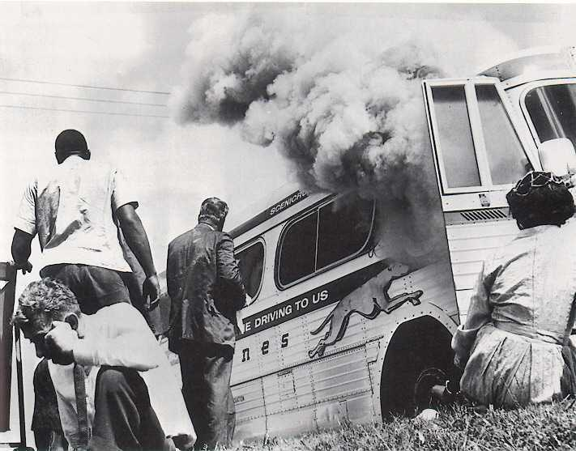

Slide 9
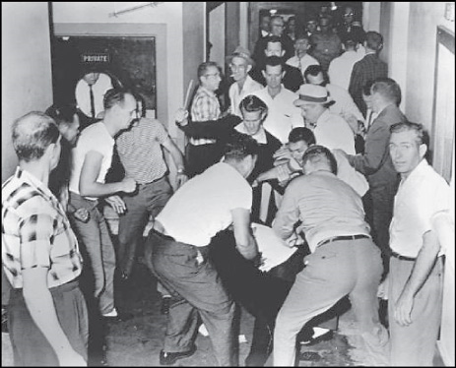

Slide 10
“I guess it is easy for those who have never felt the stinging darts of segregation to say, ‘Wait.’ But when you have seen vicious mobs lynch your mothers and fathers at whim; when you have seen hate-filled policemen curse, kick, brutalize and even kill your black brothers and sisters;…when you see the vast majority of your twenty million negro brothers smothering in the air-tight cage of poverty; …when you have to concoct an answer for a five year-old son asking…’Daddy, why do white people treat colored people so mean?’…then you will understand why we find it difficult to wait.”

Slide 11
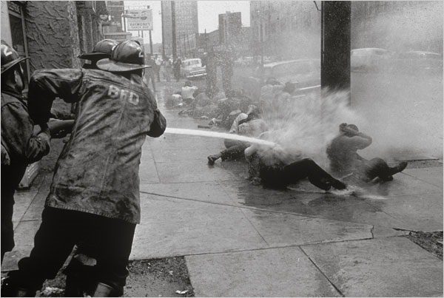

Slide 12
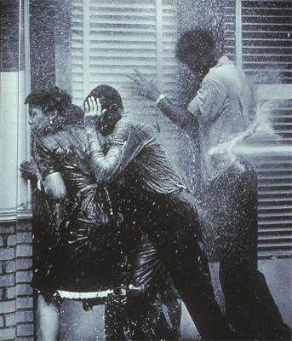

Slide 13
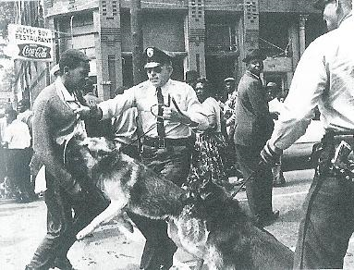
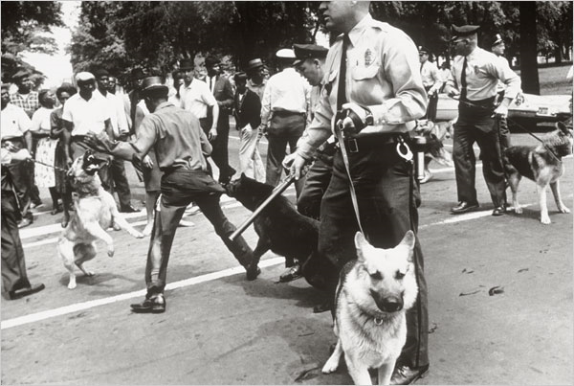

Slide 14
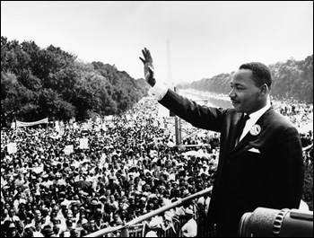
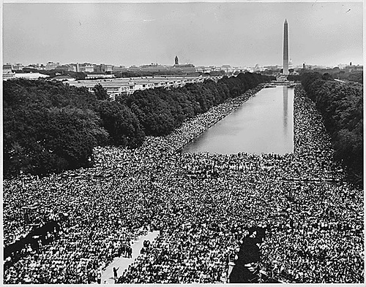
http://www.pbs.org/wgbh/amex/eyesontheprize/resources/vid/09_video_summer_qt.html
Freedom Summer

Slide 15
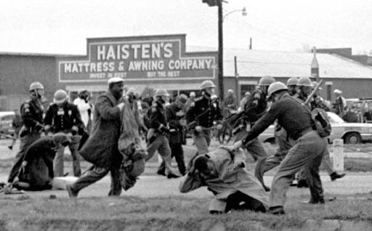
The Selma Campaign

Slide 16
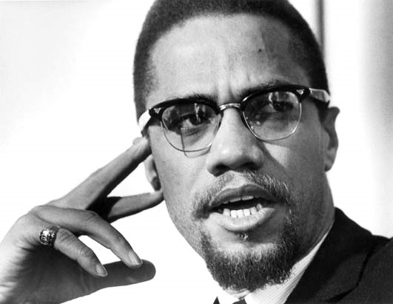
Malcolm X

Slide 17
“Concerning nonviolence: it is criminal to teach a man not to defend himself when he is the constant victim of brutal attacks. It is legal and lawful to own a shotgun or a rifle. We believe in obeying the law…The time has come for the American Negro to fight back in self-defense whenever and wherever he is being unjustly
And unlawfully attacked.”
Malcolm X

Slide 18
Change in Ideas
“I have prayed with fellow Muslims whose eyes were the bluest of blue, whose hair was the Blondest of blond, and whose skin was the whitest of white.”

Slide 19
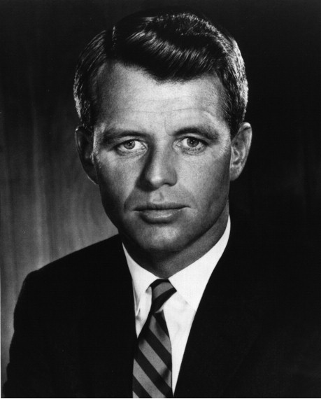
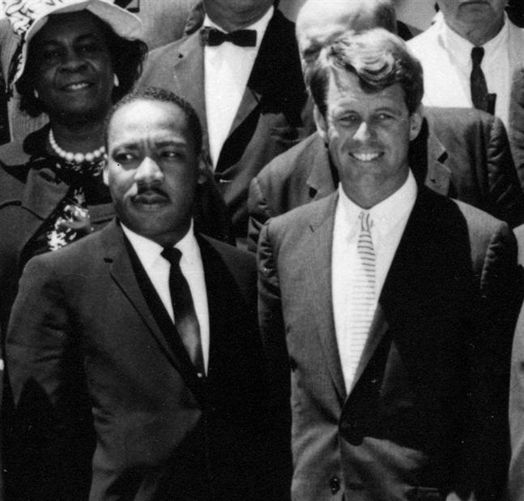
Poor People’s March
http://www.youtube.com/watch?v=x1L8y-MX3pg
Robert Kennedy

Slide 20
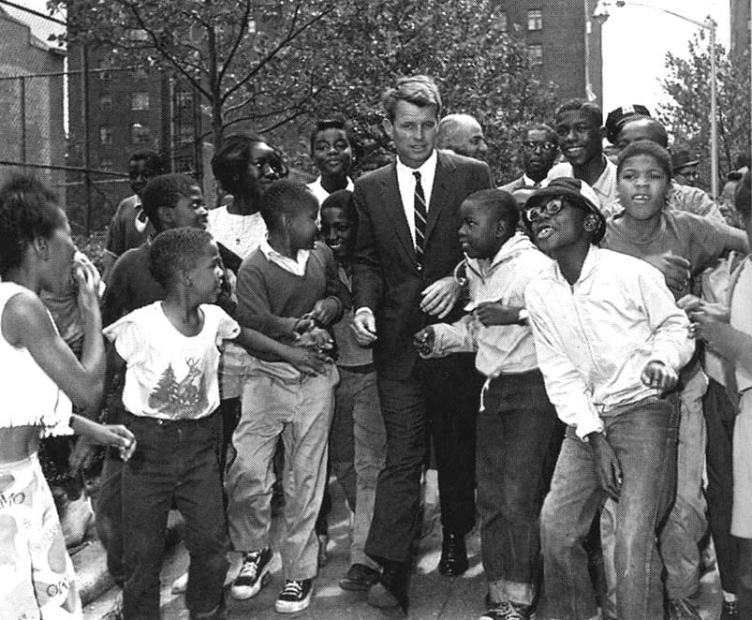

Slide 21
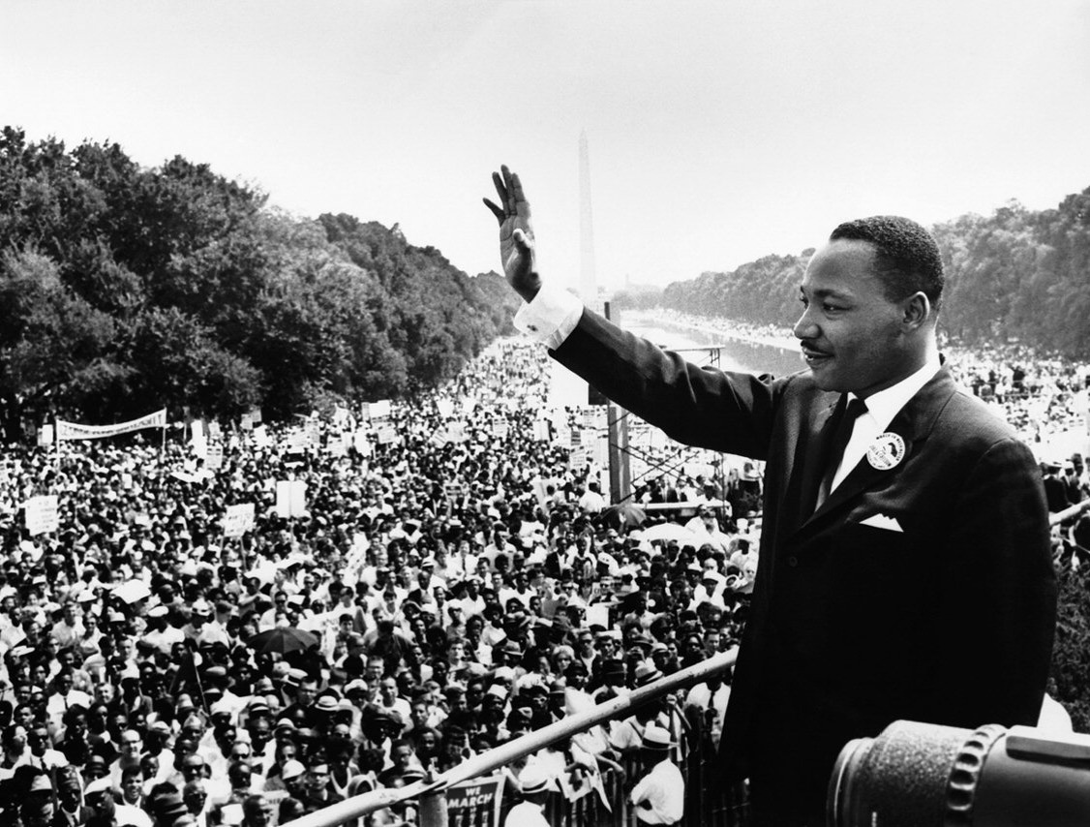

Slide 22
In what ways has Martin Luther King’s Dream been realized and in what ways is there more to be done?

