Slide 1
8A. Religious Revival
Today in the U. S., the Christian faith is back in the center of things. -- Time magazine, 1954
Church membership: 1940 → 64,000,000 1960 → 114,000,000
Television Preachers:
1. Catholic Bishop Fulton J. Sheen → “Life is Worth Living”
2. Methodist Minister Norman Vincent Peale → The Power of Positive Thinking
3. Reverend Billy Graham → ecumenical message; warned against the evils of Communism.

Slide 2
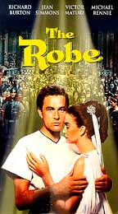
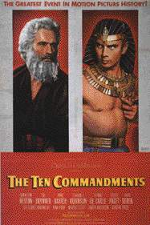
8B. Religious Revival
Hollywood: apex of the biblical epics.
The Robe The Ten Commandments Ben Hur 1953 1956 1959
It’s un-American to be un-religious! -- The Christian Century, 1954

Slide 3
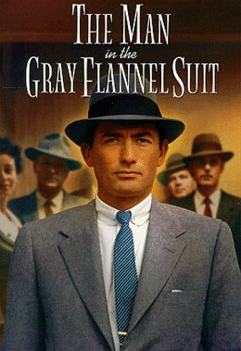
9A. Well-Defined Gender Roles
The ideal modern woman married, cooked and cared for her family, and kept herself busy by joining the local PTA and leading a troop of Campfire Girls. She entertained guests in her family’s suburban house and worked out on the trampoline to keep her size 12 figure. -- Life magazine, 1956
Marilyn Monroe
The ideal 1950s man was the provider, protector, and the boss of the house. -- Life magazine, 1955
1956 → William H. Whyte, Jr. → The Organization Man
a middle-class, white suburban male is the ideal.

Slide 4
10A. Progress Through Science
1951 -- First IBM Mainframe Computer
1952 -- Hydrogen Bomb Test
1953 -- DNA Structure Discovered
1954 -- Salk Vaccine Tested for Polio
1957 -- First Commercial U. S. Nuclear Power Plant
1958 -- NASA Created
1959 -- Press Conference of the First 7 American Astronauts

Slide 5
10B. Progress Through Science
1957 → Russians launch SPUTNIK I
1958 → National Defense Education Act

Slide 6
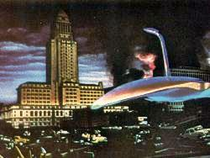
10C. Progress Through Science
UFO Sightings skyrocketed in the 1950s.
War of the Worlds
Hollywood used aliens as a metaphor for whom ??

Slide 7
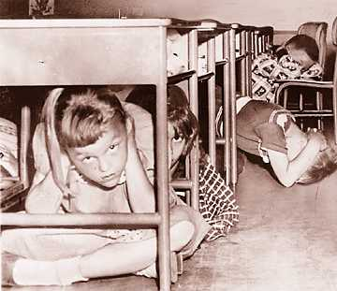
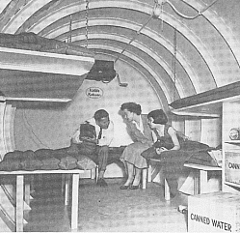
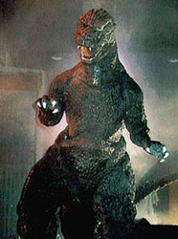
10D. Progress Through Science
Atomic Anxieties:
“Duck-and-Cover Generation”
Atomic Testing:
1946-1962 → U. S. exploded 217 nuclear weapons over the Pacific and in Nevada.

Slide 8
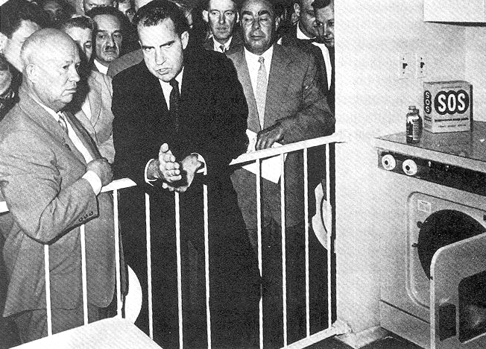
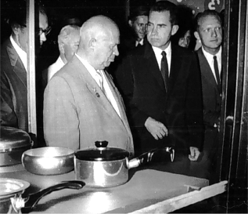
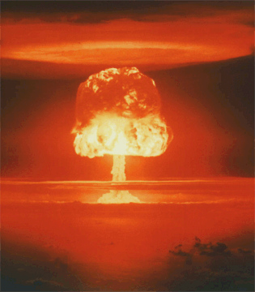
The 50s Come to a Close
1959 → Nixon-Khrushchev “Kitchen Debate”
Cold War -----> Tensions
<----- Technology & Affluence

Slide 9
Class Discussion Topic:
The postwar era witnessed tremendous economic growth and rising social contentment and conformity. Yet in the midst of such increasing affluence and comfortable domesticity, social critics expressed a growing sense of unease with American culture in the 1950s.
Assess the validity of the above statement and explain how the decade of the 1950s laid the groundwork for the social and political turbulence of the 1960s.

