Slide 1
6A. Television
1946 → 7,000 TV sets in the U. S. 1950 → 50,000,000 TV sets in the U. S.
Television is a vast wasteland. → Newton Minnow, Chairman of the Federal Communications Commission, 1961
Mass Audience → TV celebrated traditional American values.
Truth, Justice, and the American way!

Slide 2
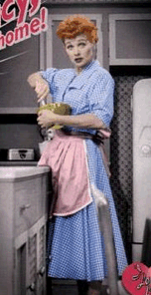
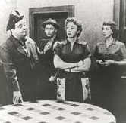
6C. Television - Family Shows
Glossy view of mostly middle-class suburban life.
But...
I Love Lucy
The Honeymooners
Social Winners?... AND… Loosers?

Slide 3
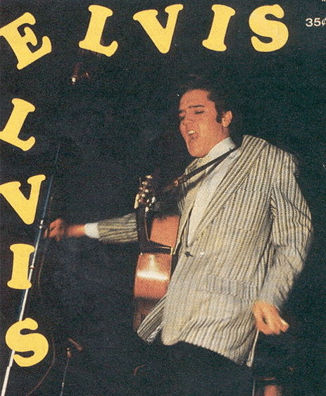
7A. Teen Culture
In the 1950s → the word “teenager” entered the American language.
By 1956 → 13 mil. teens with $7 bil. to spend a year.
1951 → “race music” → “ROCK ‘N ROLL”
Elvis Presley → “The King”

Slide 4
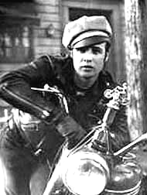
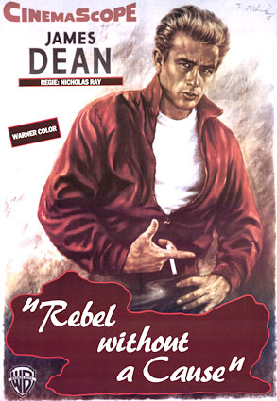
7B. Teen Culture
“Juvenile Delinquency” ???
1951 → J. D. Salinger’s A Catcher in the Rye
Marlon Brando in The Wild One (1953)
James Dean in Rebel Without a Cause (1955)

