Slide 1
The 1920’s
The Roaring Jazz Age or the Turbulent Twenties?

Slide 2
Jazz, Sports, Radio and Religion
Part IV

Slide 3
Harlem Renaissance
Flourishing of artistic development
Glowing pride in black culture- “The New Negro”
Langston Hughes
Zora Neale Hurston
Harlem Jazz
Savoy, Cotton Club
Duke Ellington
Count Basie
Benny Goodman
Louis Armstrong

Slide 4
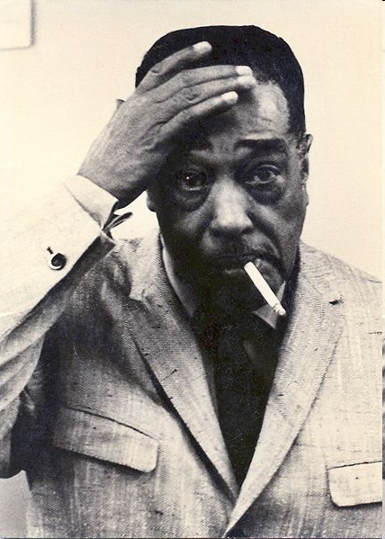
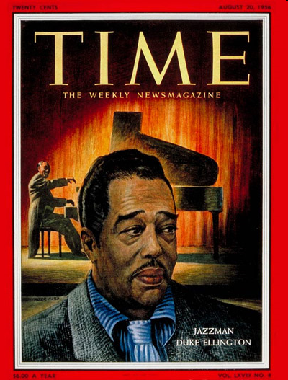
THE DUKE

Slide 5
IF WE MUST DIE - Claude McKay
“If we must die, let it not be like hogs
Hunted and penned in an inglorious spot,
While round us bark the mad and hungry dogs….
What though before us lies an open grave?
Like men we’ll face the murderous, cowardly pack,
Pressed to the wall, dying, but fighting back!”

Slide 6
Langston Hughes
“We build our temples for tomorrow, strong as we know how, & we stand on the top of the mountain, free within ourselves”

Slide 7
“The Lost Generation”
Rise of a new generation of American Writers
Reflected gloom of WWI and scorned “superficial” middle class
Ernest Hemingway – A Farewell to Arms
F. Scott Fitzgerald – This Side of Paradise & The Great Gatsby

Slide 8
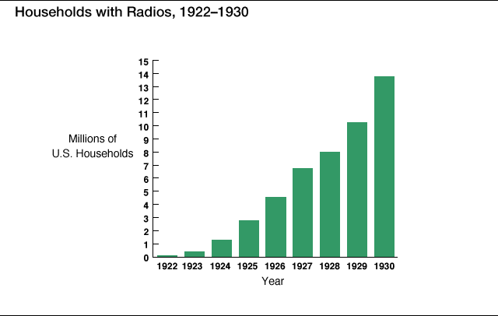

Slide 9
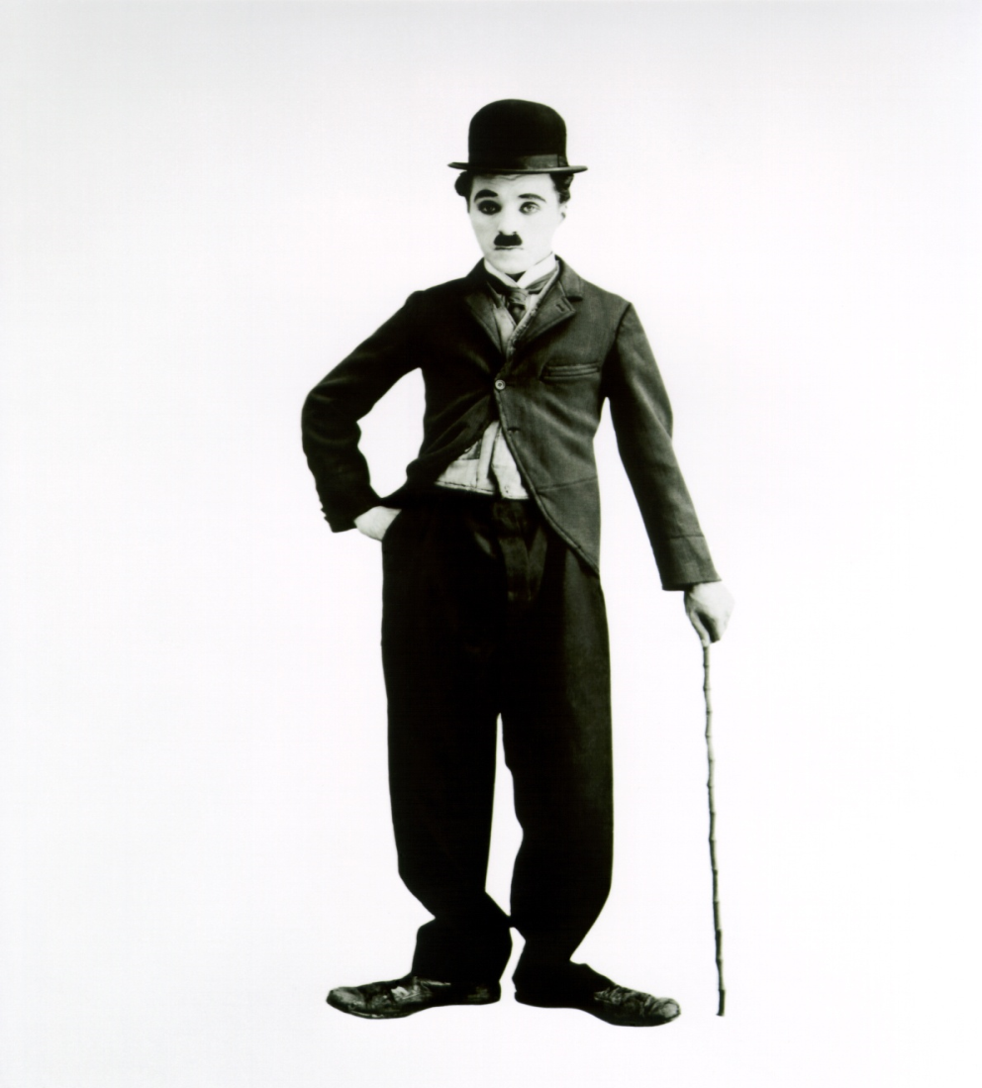
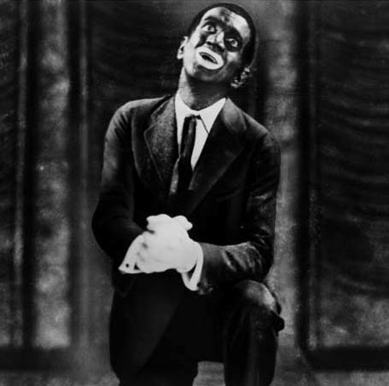
1927 – 1st Talkie – The Jazz Singer
CHARLIE CHAPLIN
AL JOLSON

Slide 10
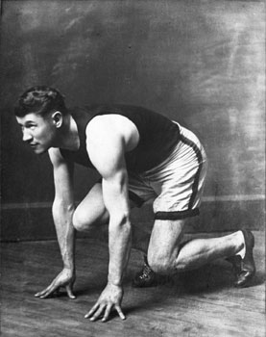
Sports of the 1920s
BABE RUTH
JIM THORPE

Slide 11
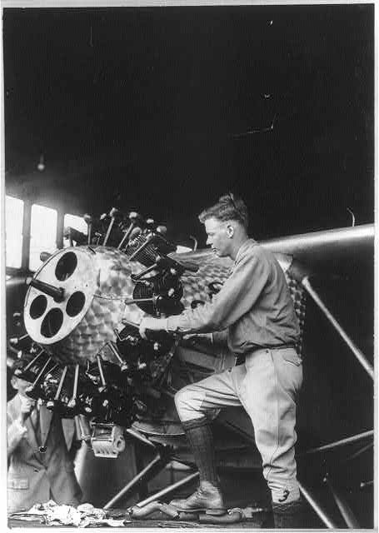
Charles Lindbergh – “Spirit of St. Louis”, non stop NY – Paris (1927)

Slide 12
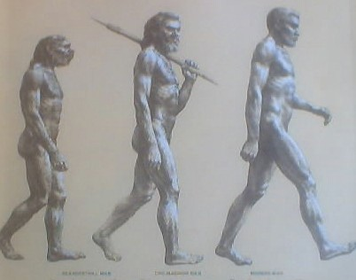
Monkey Business
The Scopes Monkey Trial
1925
John T Scopes (teacher)
Dayton, Tennessee
Teaches theory of evolution to his class
Tennessee state law outlawed the teaching of anything but the Biblical creation story
William Jennings Bryan – Prosecutor (fundamentalist)
Clarence Darrow (ACLU) – defense attorney

Slide 13
Science vs. Religion
Bryan represented many Americans who felt that evolution contradicted their religious beliefs
Darrow “Today it’s the public school teachers, tomorrow the private, the next day the preacher and the lecturers, the magazines, the books, the newspapers”
Scopes loses and is fined $100
Bryan who was called by Darrow as a witness came to represent “narrow-minded” Americans

Slide 14
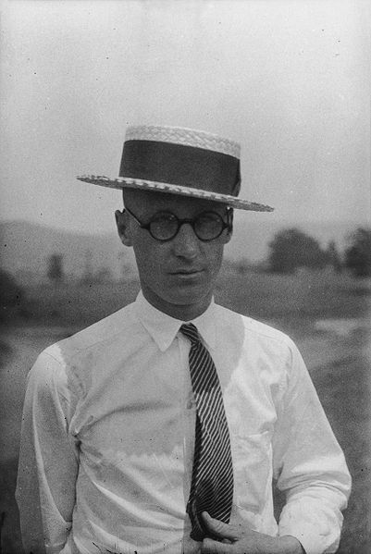
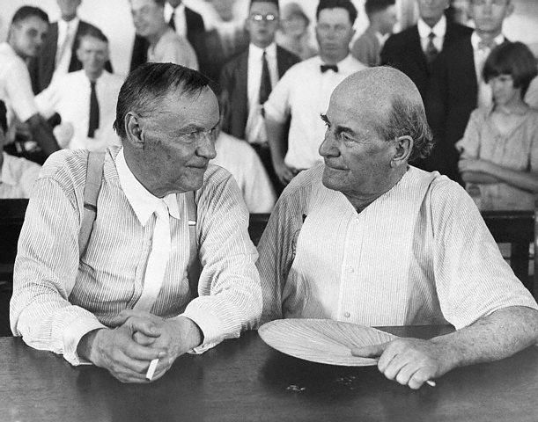
John T Scopes
Darrow
Jennings Bryan

Slide 15
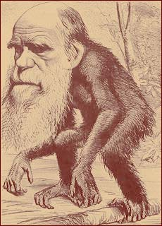

Slide 16
