Slide 1
The 1920’s
The Roaring Jazz Age or the Turbulent Twenties?

Slide 2
29 & 30 – Republican Presidents
“A return to normalcy” – Harding 1920
The Ohio Gang
Teapot Dome Scandal – Albert B. Fall
“Keep it cool with Coolidge” 1924
“The business of government is business”-Silent Cal
Prosperity and Thrift
Very popular after Harding’s corruption
“I do not choose to run for president in nineteen twenty eight”
Republican capitalism
High Tariffs – to stimulate domestic business
Trickle-down “a rising tide floats all boats”

Slide 3
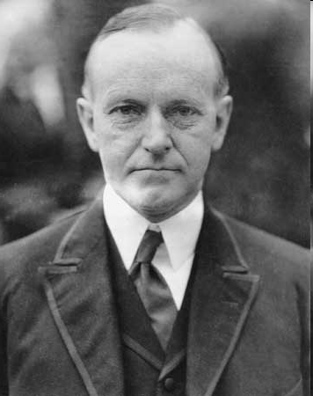
Returning to Normal and Keeping it Cool

Slide 4
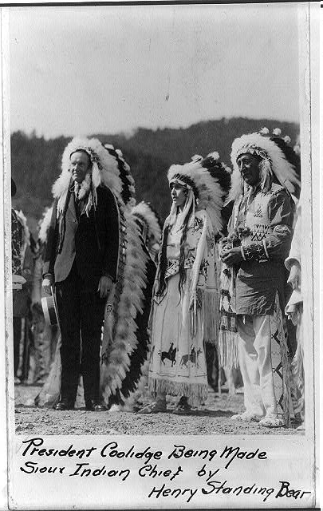

Slide 5
Cars and Consumerism
Part IV

Slide 6
Henry Ford
Assembly Line Production- cut production time in ½
Model T
Output
1920-1.9 mill
1930-5 mill
Payment Plans
Workers
Gave birth to 400,000 miles of new roads
Road side businesses

Slide 7
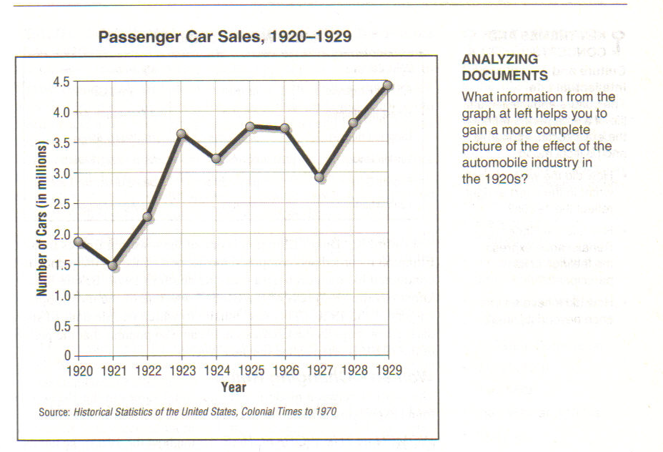

Slide 8
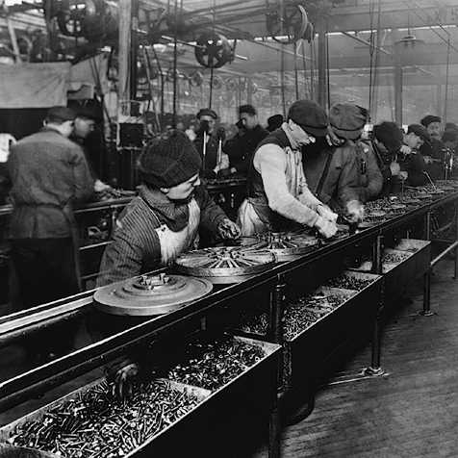
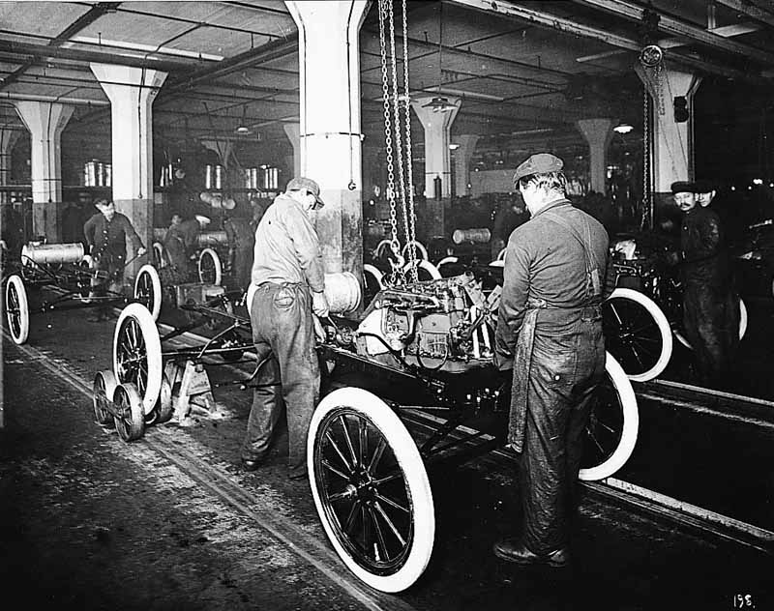

Slide 9
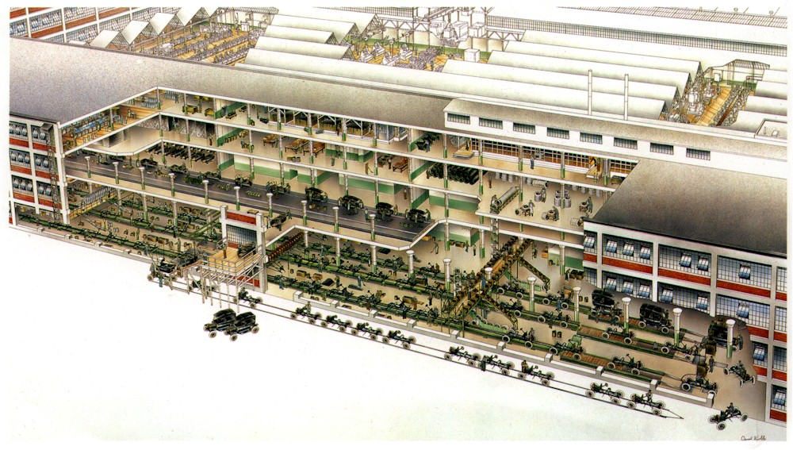

Slide 10
Working on the Chain Gang?
“The chain system [assembly line] you have is a slave driver! My God! Mr. Ford. My husband has come home and thrown himself down and won’t eat his supper – so done out! Can’t it be remedied?……..That $5 a day is a blessing one bigger than you know but oh they earn it”
- Wife of a Ford worker

Slide 11
Creating Consumers
1926 – 75% of cars on credit
Items that were “pleasing” to look at
Planned obsolescence – creating something that is planned to go out of style
Chain-stores, A&P 14,000 by 1925
Advertising – pre WWI = $500 million by 1929 $3 billion
Magazines, newspaper, billboards, radio
Targeted women
Slogans, jingles, celebrities

Slide 12
Marketing Wisdom
“To keep America growing we must keep America working, and to keep America working we must keep them wanting; wanting more than the bare necessities; wanting the luxuries and frills that make life so much more worthwhile, and installment selling makes it easier to keep Americans wanting”
- Car dealer

Slide 13
Women and African Americans in the 1920s
PART III

Slide 14
Flappers – The Exception or the Rule??
The “new woman”
“Stylish, adventurous, independent, career minded”
No more corsets, short skirts instead
Bobbed or short hair style
Participated in sports and drove cars
Taxi drivers, teachers, stenographers, pilots etc.
Most women were still house wives (married & older, a small percentage were flappers (young & single)

Slide 15
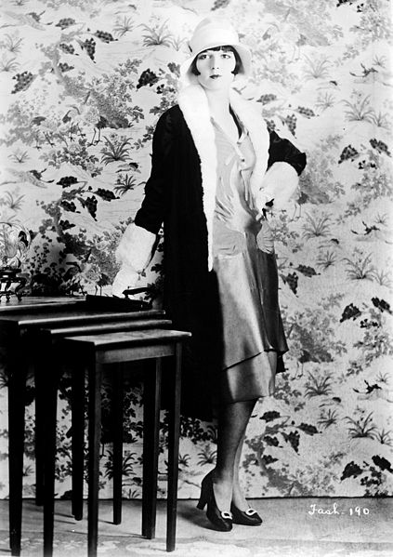

Slide 16
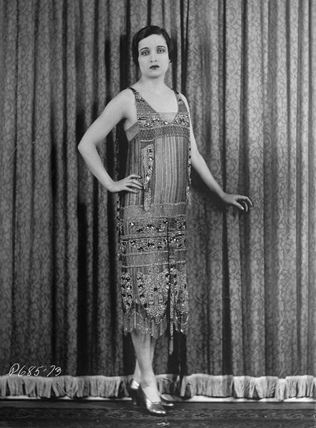

Slide 17
W.E.B. Du Bois
We Return
We return from fighting
We return fighting

Slide 18
Historian David Levering Lewis Wrote….
“In the course of his long, turbulent career, W. E. B.
Du Bois attempted virtually every possible solution to the problem of twentieth-century racism”

Slide 19
Violence Erupts
By late 1919 25 Race Riots erupted
“People [African Americans] were seen to flee from their burning home, some with babies in their arms”
“The colored troops fought nobly [In WWI]. We have something to fight for now”

Slide 20
The Great Black Migration
General trend of Urbanization
1920s 800,000 Blacks moved North

Slide 21
The Fight For Equality Begins
NAACP- W E B Dubois (1909)
Formed the anti-lynching committee
The Crisis – newsletter which published accounts of violence
Appealed to the well educated
Marcus Garvey (UNIA) -“We shall now organize”
Aimed to unite all those of African descent worldwide, lost hope of achieving equality in America
“Back to Africa”
Black owned businesses
Appealed to the working class
“He made black people proud, he taught them that black is beautiful”

Slide 22
White Backlash
1920 100,000 new members, fueled by the red-scare
Nativism – white Protestant American born, white supremacy
The new KKK
1920-over 700 lynchings
North & Mid-West
Infiltrated all aspects of society

Slide 23
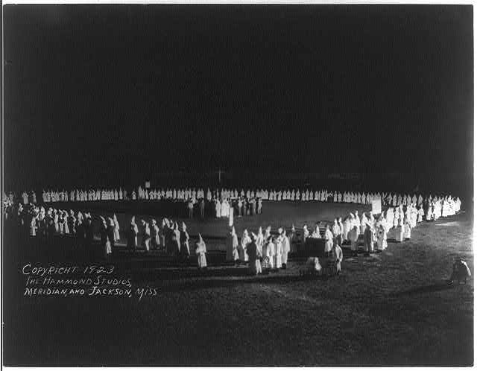

Slide 24
